Slide 1
The All of Us Research Program
Updated as of April 17, 2023
All of Us and the All of Us logo are registered service marks of the U.S. Department of Health and Human Services.
Notes:
Updated April 17, 2023
Consortium members: To check for the latest version, visit https://joinallofus.atlassian.net/wiki/spaces/EnCo/pages/2062202/Resources+for+Spokespeople.

Slide 2
All of Us Research Program Key Definitions & Acknowledgement
Engagement: A broad range of relationship-building bidirectional interactions, including information sharing, consultation, collaboration in decision making, and empowered action between the program, people, awardees, and other partners.
Outreach: Unidirectional interaction, such as providing materials and information to an audience.
Recruitment: Facilitating enrollment in the program.
Retention: Ongoing activities with participants after enrollment.
Source: All of Us protocol
Acknowledgement: Pyxis Partners is funded by the Division of Engagement and Outreach, All of Us Research Program, National Institutes of Health, Award Number: OD028404

Slide 3
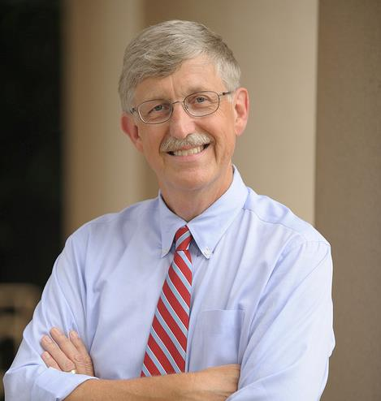
What is the NIH All of Us Research Program?
People Have Different Disease Risks
The All of Us Research Program is a historic, longitudinal effort to gather data from at least one million people living in the United States to accelerate research and improve health. By taking into account individual differences in lifestyle, socioeconomics, environment, and biology, we hope that researchers will one day uncover paths toward delivering precision medicine – or health care that is based on an individual.
“All of Us is among the most ambitious research efforts that our nation has undertaken!”
Francis Collins, M.D., Ph.D.
Former NIH Director. Science Advisor to the
President and Co-Chair of the President’s Council
of Advisors on Science and Technology (PCAST)
The All of Us Research Program is part of the broader Precision Medicine Initiative.

Slide 4
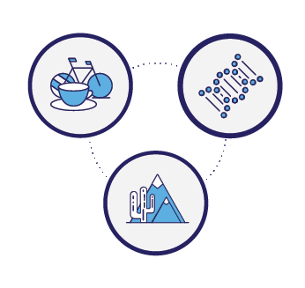
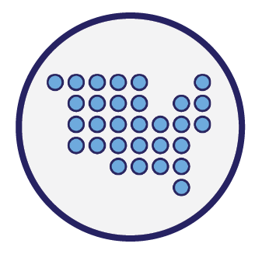
What is precision medicine?
Lifestyle
Biology
Precision medicine is an emerging approach for personalized health care that takes into account individual variability in lifestyle, socioeconomics, environment, and biology.
It is a radical shift in how each of us can receive the best care possible based on our unique makeup.
Environment

Slide 5
Kinds of questions this resource may help answer
How may we prevent the chronic pain that affects more than 100 million people across the U.S.
each year?
Or may slow or potentially stop different kinds of dementia?
Or may help researchers develop more cancer cures that will work the first time, so we may skip painful trial-and-error chemotherapy?
Or develop pain medicine that potentially may not be addictive?
Or may develop better treatments for diabetes, which affects almost 10% of Americans–or may potentially prevent diabetes altogether?
Or may drive sustainable interventions that may support health equity?

Slide 6
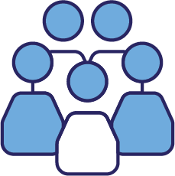
Why do we even need the All of Us Research Program?
People/Patients
Health Care Providers
Biomedical Researchers
Patients may not be served well by treatments designed for the “average” patient. We hope in the future that All of Us will help advance precision medicine.
Many people and populations have been left out of biomedical research, and thus, often left out of health care solutions.
Health problems can take years to unravel and require much trial-and-error.
Patients may not have access to, or make use of, their own health data.
Precision medicine research is still in the early days, so providers do not have enough information available to provide precision care for many conditions.
Developing individualized approaches to care often requires time.
It can be difficult to coordinate care between many different providers, especially with medical records and key data scattered in different silos.
Researchers spend a lot of time and resources creating new IT systems, databases, and analytic tools.
They also face enormous costs and time just to recruit participants.
Data collection is often not standardized, and data can be siloed and difficult to integrate.
A single lab’s resources may not be sufficient to answer the research questions that matter.

Slide 7
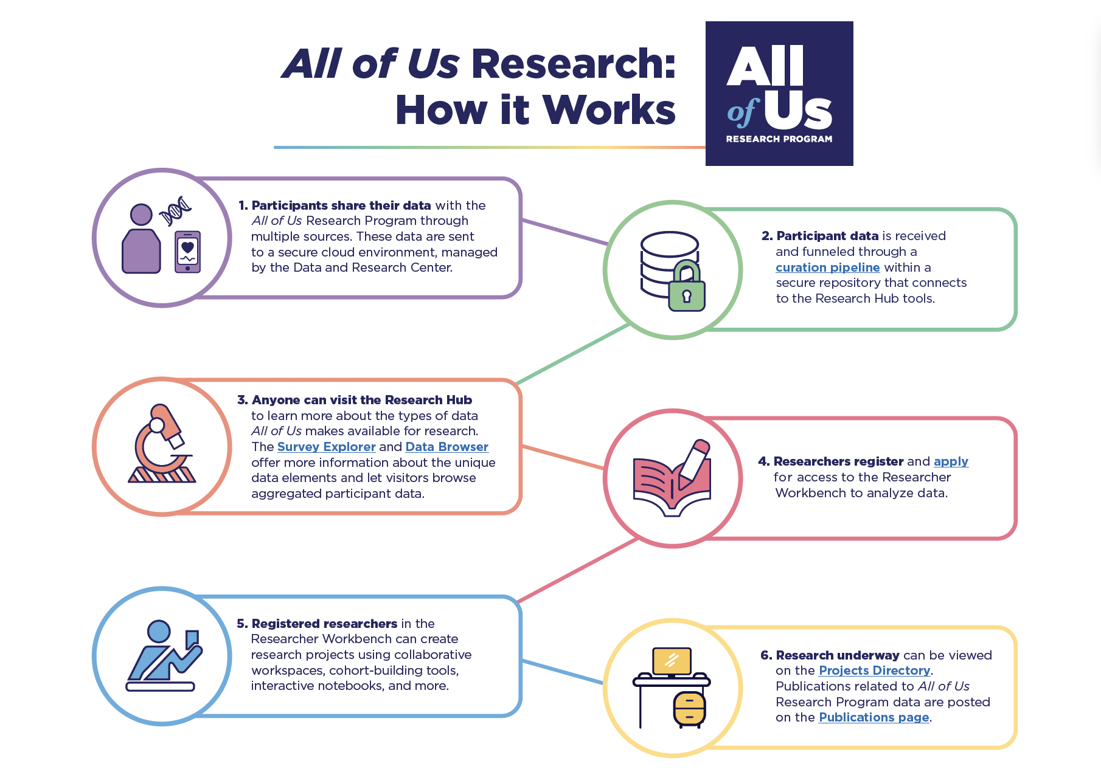

Slide 8
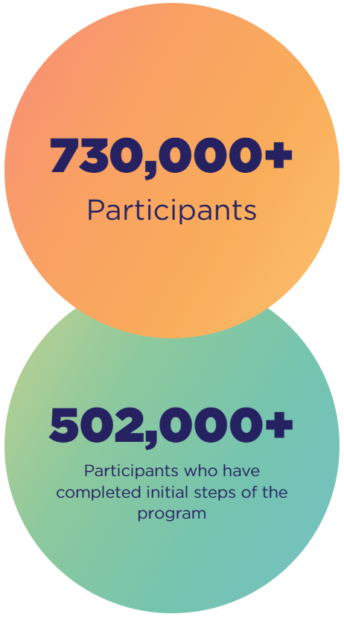
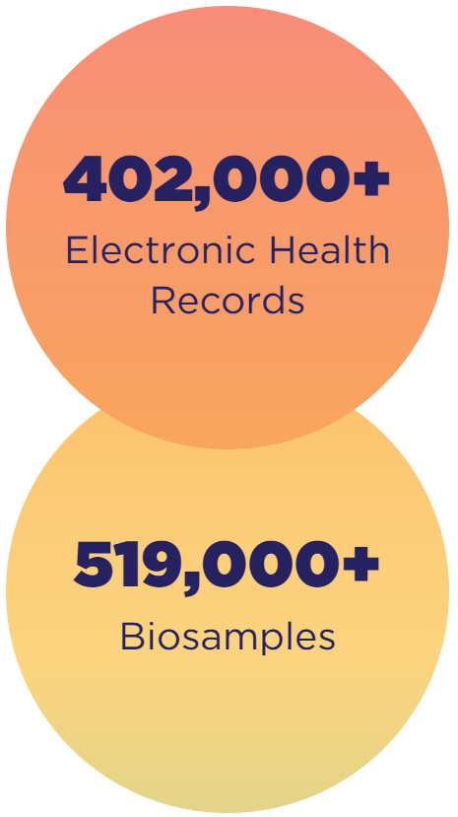
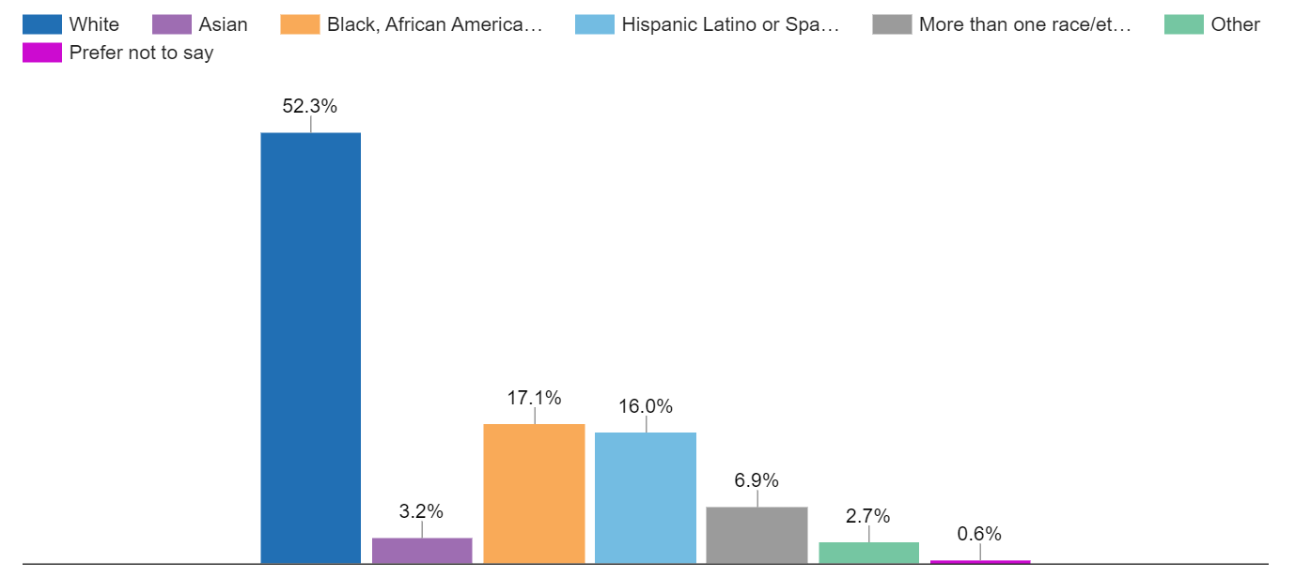
Working towards a million participants who reflect the diversity of our country
As of November 5, 2023
https://www.researchallofus.org/data-tools/data-snapshots/
Notes:
All of Us is different in many ways.
All of Us is not a disease specific research program, rather we are creating a data base of information that could inform thousands of studies and cover a wide variety of health conditions.
All of Us is diverse and aims to ensure that the participant community reflects the true diversity of the United States.
All of Us is huge. The goal is to enroll one million or more volunteers and in building one of the largest health databases of its kind researchers may see patterns that wouldn’t be visible at a smaller scale.
All of Us participants are partners in the program engaging at every level to ensure the program is living true to its core values.

Slide 9
All of Us community and provider partner network (as of April 2023)
Note: These are not approved lockups and should not be repurposed on assets.
Notes:
Network of trusted partners

Slide 10
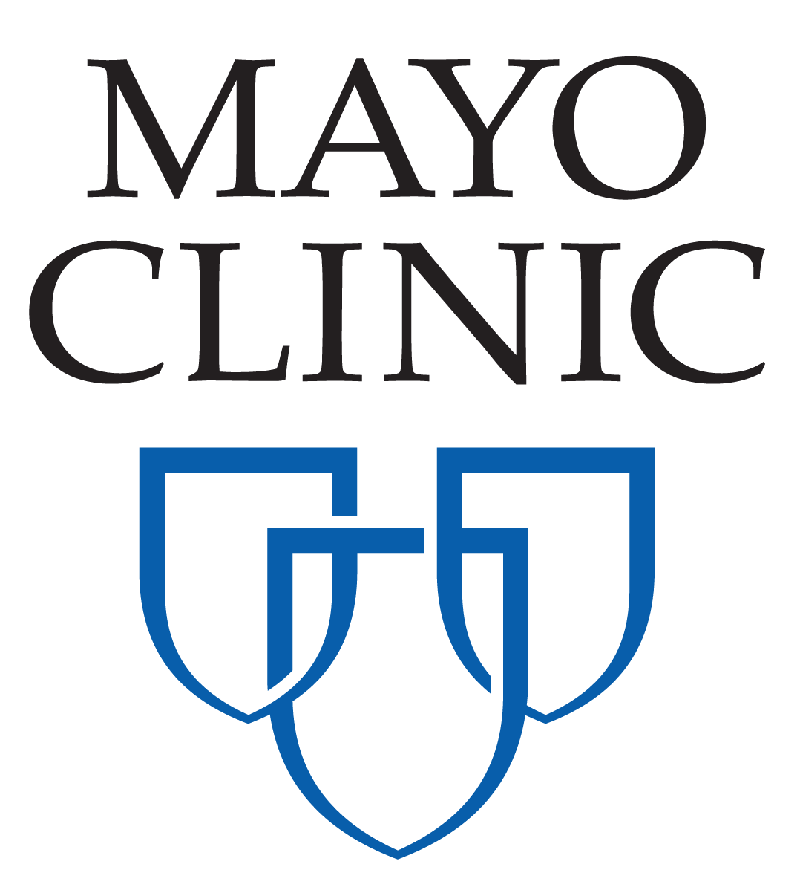
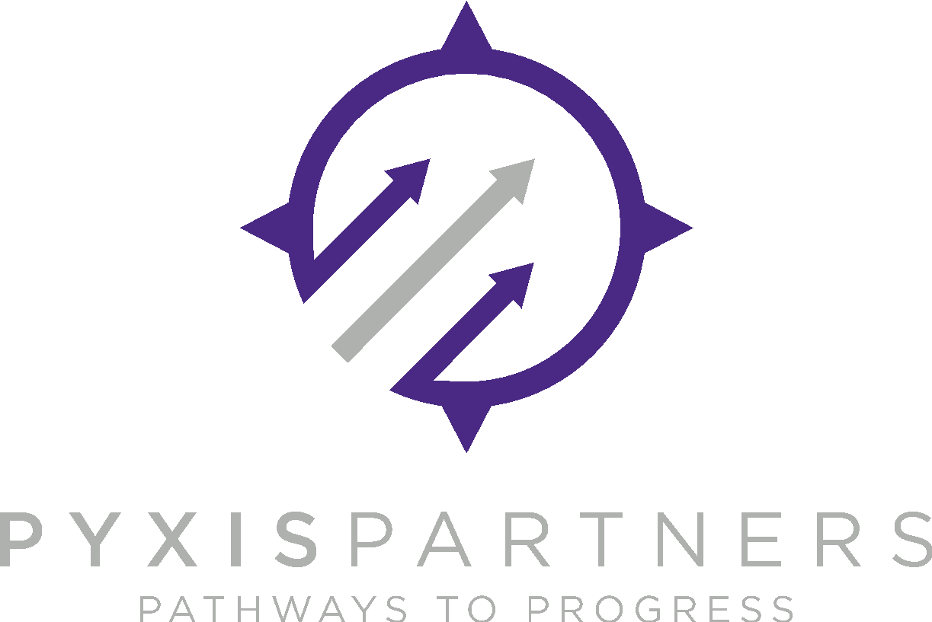
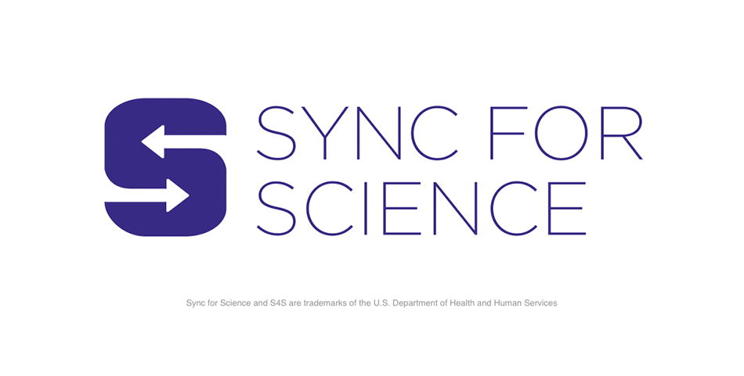
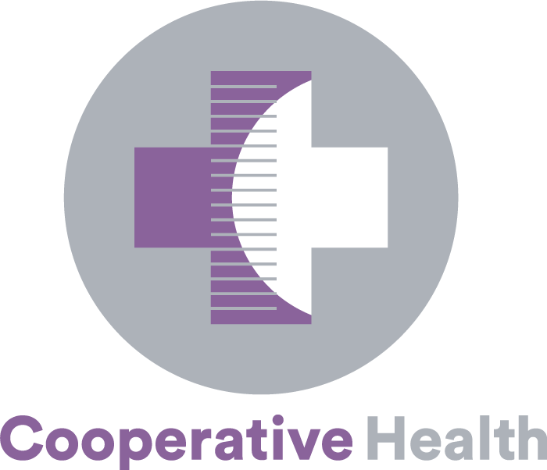
All of Us consortium members (beyond community partners, as of April 2023)
The Participant Center
Communications & Engagement
HPO Network
(Health Care Provider Organizations)
Illinois Precision Medicine Consortium
RMCs
All of Us
New England
Trans America
Consortium
New York City Consortium
All of Us Southeast Enrollment Center
All of Us California
All of Us Southern Network
HPO Lite
All of Us Puerto Rico
University of Arizona and Banner Health
Nutrition for Precision Health (NPH)
All of Us Wisconsin
All of Us Pennsylvania
FQHCs (Federally Qualified Health Centers)
VA Medical Centers
Participant Technology Systems Center (PTSC)
Biobank
Data & Research Center (DRC)
Genomics Partners
Note: These are not approved lockups and should not be repurposed on assets.
Notes:
Big picture:
• This slide is meant to help the audience understand the many, many partners who make this program possible.
• This is current as of April 2023. We will make periodic updates as new awards are made or project periods end. Consortium members: please check Confluence for the latest version, here: https://joinallofus.atlassian.net/wiki/spaces/EnCo/pages/2062202/Talking+Points+Resources+for+Spokespeople. Other partners: email us at AoU_Talks@PalladianPartners.com to confirm you have the latest version.

Slide 11
Learn More: All of Us California Enrollment Partners, CPGI & NCEP Network
California Enrollment Partners
California Community Provider Gateway Initiative (CPGI) & National Community Engagement Partners (NCEP) Network
University of California Davis Health:
https://allofus.ucdavis.edu/
University of California San Francisco:
https://www.joinallofus.org/california
University of California Irvine Health:
https://allofus.health.uci.edu/
University of California San Diego Health:
https://www.allofusucsd.org/
University of Southern California: Keck School of Medicine: https://www.joinallofus.org/california
Cedars Sinai Medical Center: https://www.joinallofus.org/california
El Centro Regional Medical Center: https://www.joinallofus.org/california
U.S. Department of Veterans Affairs: https://www.joinallofus.org/va
San Ysidro Health: https://www.joinallofus.org/san-ysidro-health
San Diego Blood Bank: https://meet.sandiegobloodbank.org/all-of-us-research-program
Notes:
Definitions:
Community Provider Gateway Initiative (CPGI) Network: Our Community and Provider Gateway Initiative Partners are national, regional, and local organizations with deep reach into communities that have been historically underrepresented in biomedical research. These organizations help bridge trust and serve as program validators in communities across the country. CPGI Partners work closely with Pyxis to develop and execute a Scope of Work consistent with the All of Us Research Program goals of enrollment and research engagement.
National Community Engagement Partners (NCEP): NCEPs conduct a wide range of activities, including engaging with and facilitating enrollment and retention of communities historically underrepresented in biomedical research and contributing to the body of knowledge supporting the science of community engagement. Several partners engage researchers from diverse backgrounds to utilize the All of Us data resources to advance precision medicine and/or healthcare providers who serve historically underrepresented communities to promote All of Us. They do not report to Pyxis Partners; however, they work collaboratively with Pyxis in the Target Markets.

Slide 12
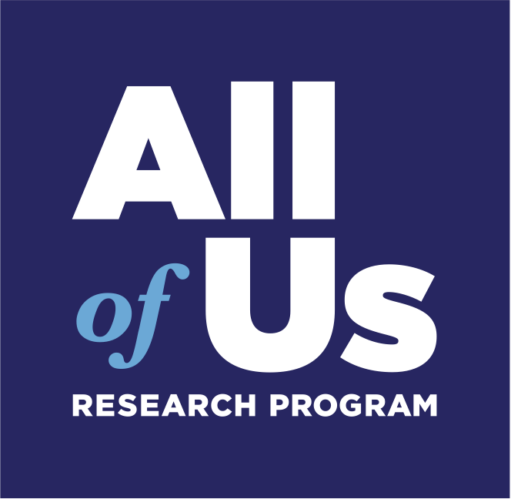
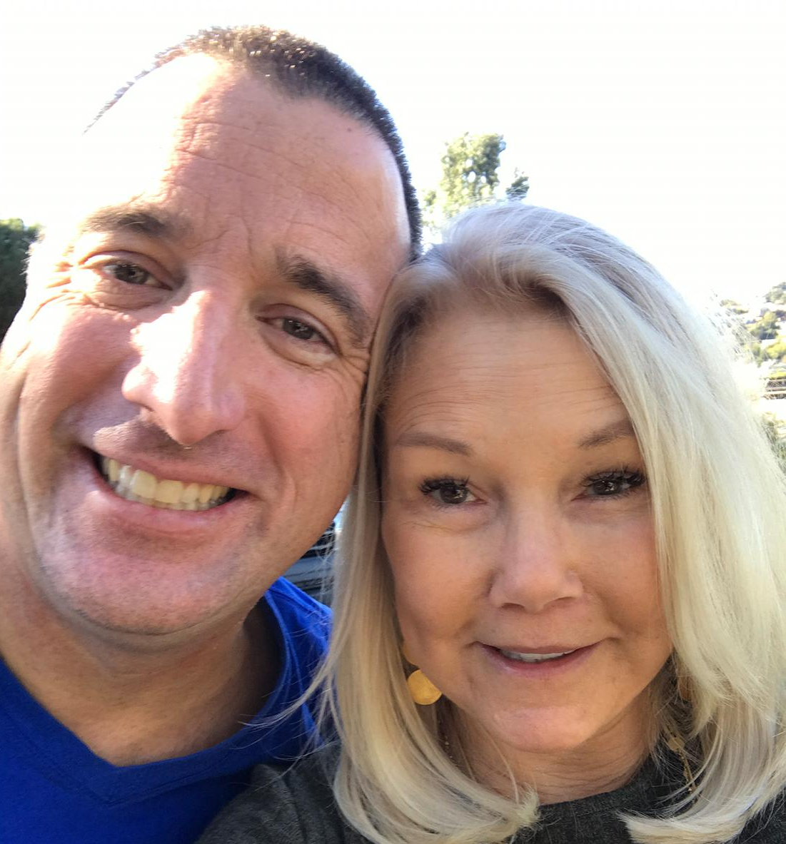
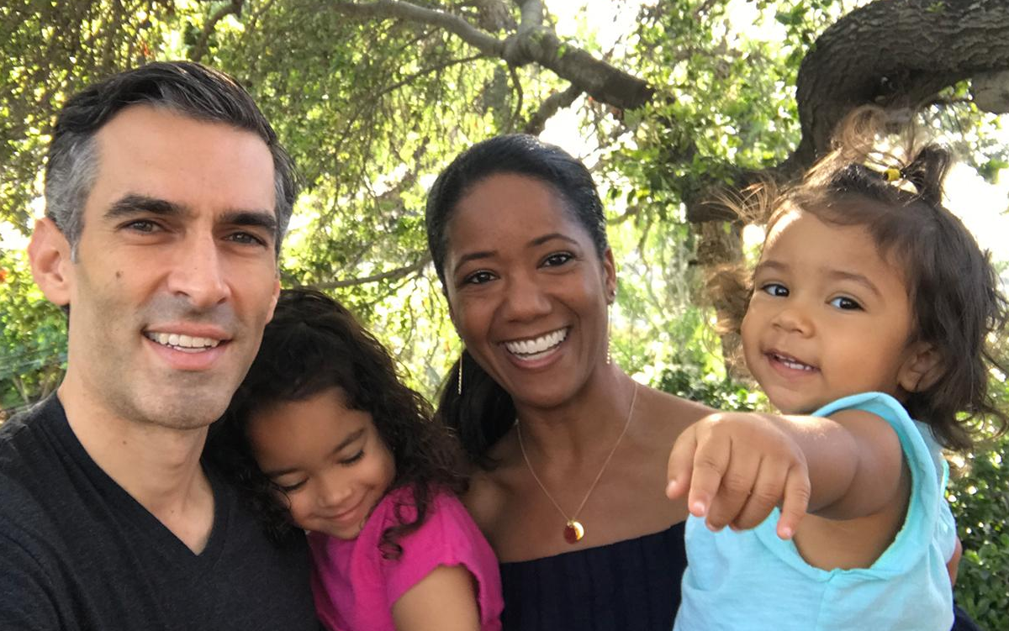
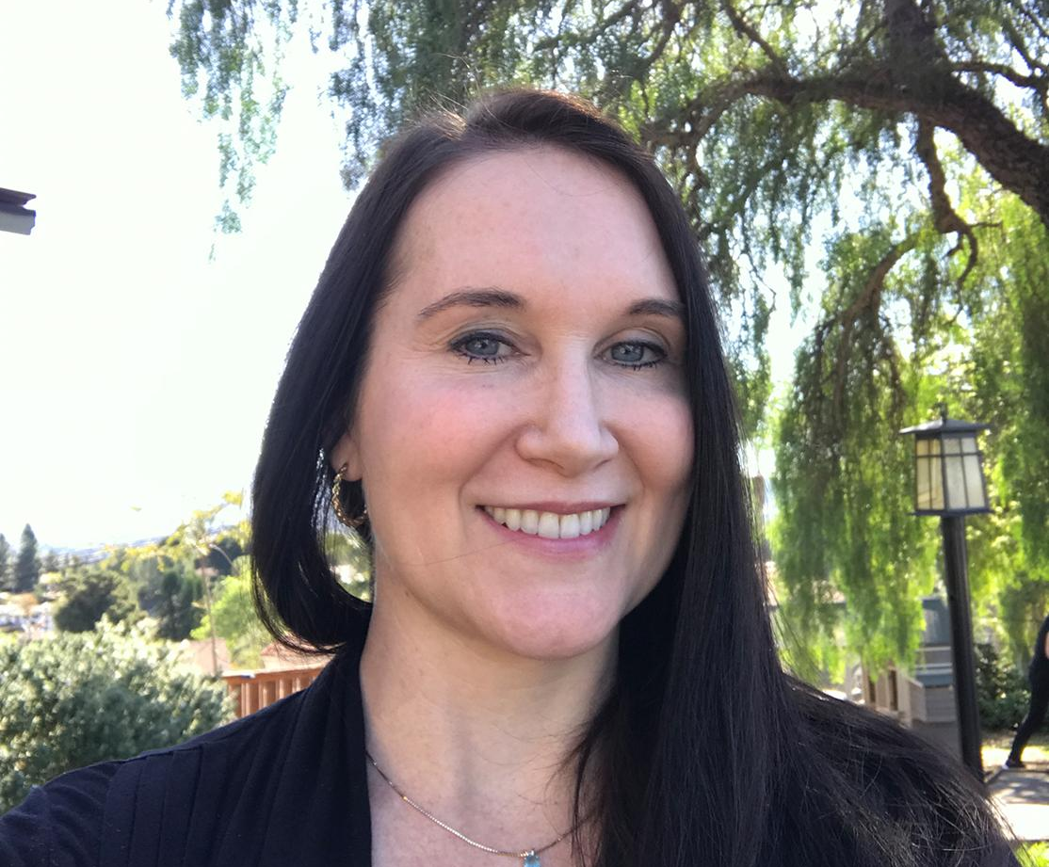
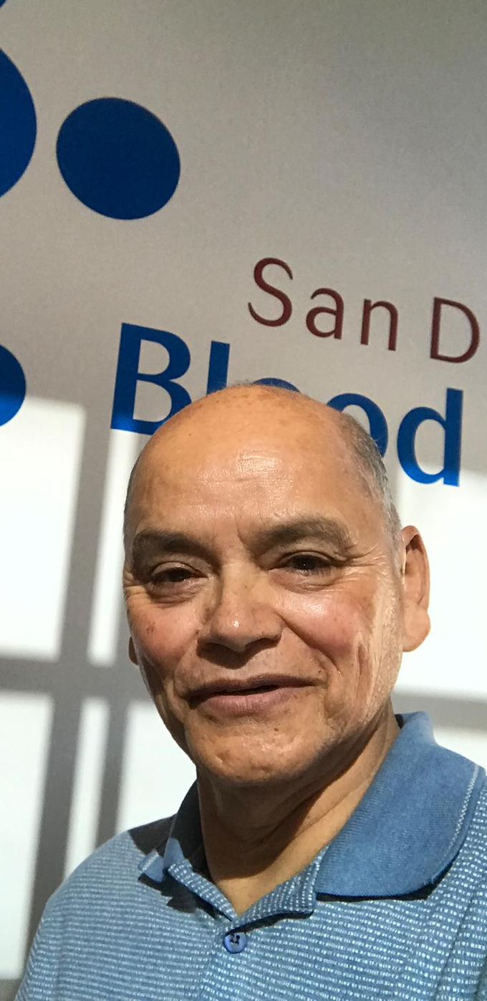
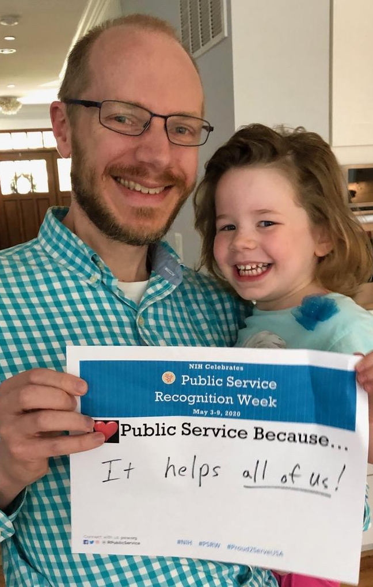
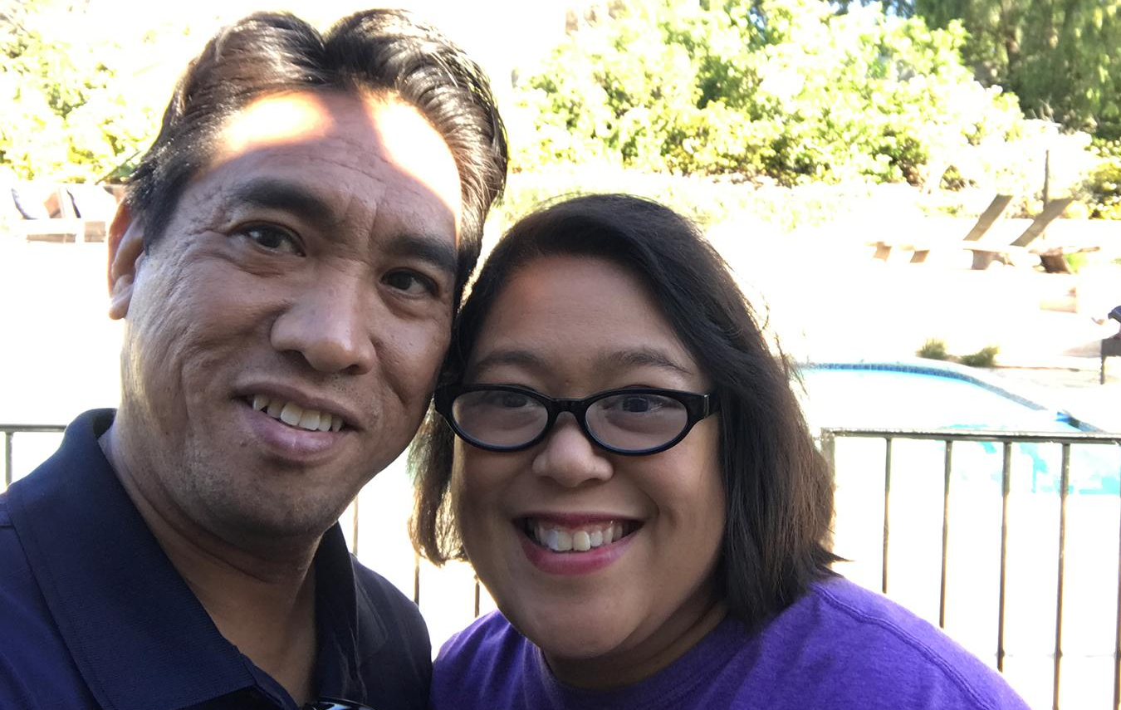
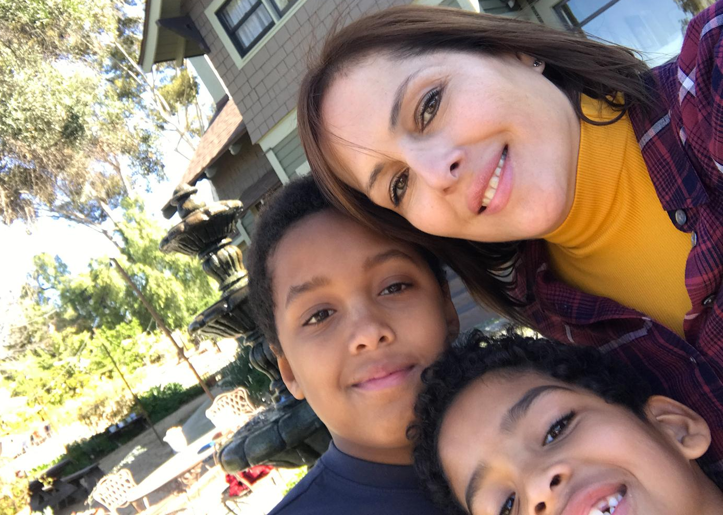
Thank you!
Social media:
@AllofUsResearch
@AllofUsCEO
#JoinAllofUs
Websites:
AllofUs.NIH.gov
JoinAllofUs.org
ResearchAllofUs.org
Thank you to our generous participants!

