Slide 1
Drought in California
CALIFORNIA DEPARTMENT OF WATER RESOURCES
CSAC PIO Briefing – July 14, 2021
Ryan Endean, DWR Public Affairs Office
Notes:
My name is Ryan Endean
Acting Deputy Director of Communications for DWR Public Affairs
Office of about 50 employees including information officers, photo, video, graphics and community outreach

Slide 2
Quick Background
DWR manages California’s water supply
The State Water Project collects, stores and delivers surface water for 29 water contractors
Serves 27 million Californians and 750,000 acres of farmland
Federal government operates the Central Valley Project (CVP)
Notes:
Manage the state’s water supply including surface and groundwater, environmental restoration, flood management
We do this in coordination with regional and local entities

Slide 3
Current Conditions
Second consecutive dry year
Warm temperatures and dry soils depleted expected snowmelt – Historic loss
2021 could be 3rd driest year on record
Reservoir storage is low
Notes:
A quick look at current conditions…
This year is our second consecutive dry year with below average precipitation and runoff
Climate change-induced early warm temperatures and extremely dry soils depleted the expected runoff water from the snowpack (which was 70 percent on April 1) resulting in historic and unanticipated reductions in the amount of water flowing to streams, rivers and reservoirs.
2021 is trending toward being the 3rd driest year on record
Reservoir storage is low throughout the state – it’s lower in Northern California where the system is more reliant on precipitation each year
These conditions have led to very low allocations for urban and agriculture customers served both the State Water Project and Central Valley Project

Slide 4
What’s Being Done
Governor’s drought proclamations
Adjusting SWP operations
Emergency drought barrier in the Delta
Notes:
The Governor has issued three drought proclamations and executive orders now covering 50 of the 58 counties. That will allow for technical assistance for local water suppliers, suspension of CEQA and some water code regulations and allows state and local agencies to respond quickly to water supply issues.
The Governor last week also announced a voluntary reduction of 15 percent of Californians water use
The Governor is also directing state agencies to lead by example in using less water in their operations.
DWR is adjusting State Water Project operations especially at our largest reservoir at Lake Oroville to conserve cold water storage for fall releases which are critical to the fall salmon run
To offset those lower releases, we have been approved for a temporary urgency change petition that allows us to deviate from water quality and water right permit requirements in the Sacramento-San Joaquin Delta. This means we can reduce the amount of water required to flow through the Delta.
Additionally, we have installed a drought barrier along the West False River in the Delta that slows saltwater intrusion into the Delta which means less upstream water is required to keep salt water out of our freshwater supply. That structure was completed in June and will be removed by November 30.

Slide 5
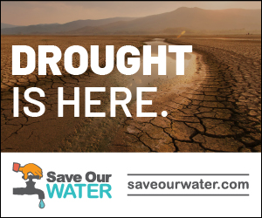
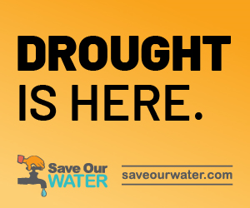
Key Public Messaging
Drought is Here
All Californians can do their part
We need to conserve now in case we have another dry year
Provide tips on how to be water efficient at home
Notes:
Since we’re all comms folks here, I want to focus a bit on our public messaging.
Our focus right now is on educating people about the drought with the tagline “Drought is Here”
We’re also educating the public on the current conditions, how we got here and what’s being done as I just outlined
But it’s also about sharing with Californians that we can all do our part to conserve and we’re in this together
Additionally, we need to conserve now in case there’s another dry year
Providing water efficiency tips for the home

Slide 6
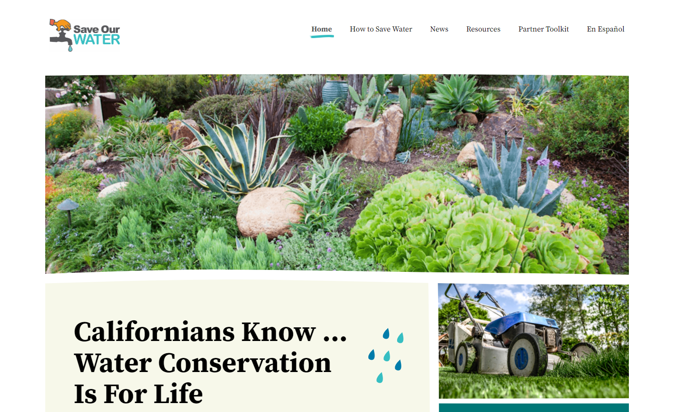
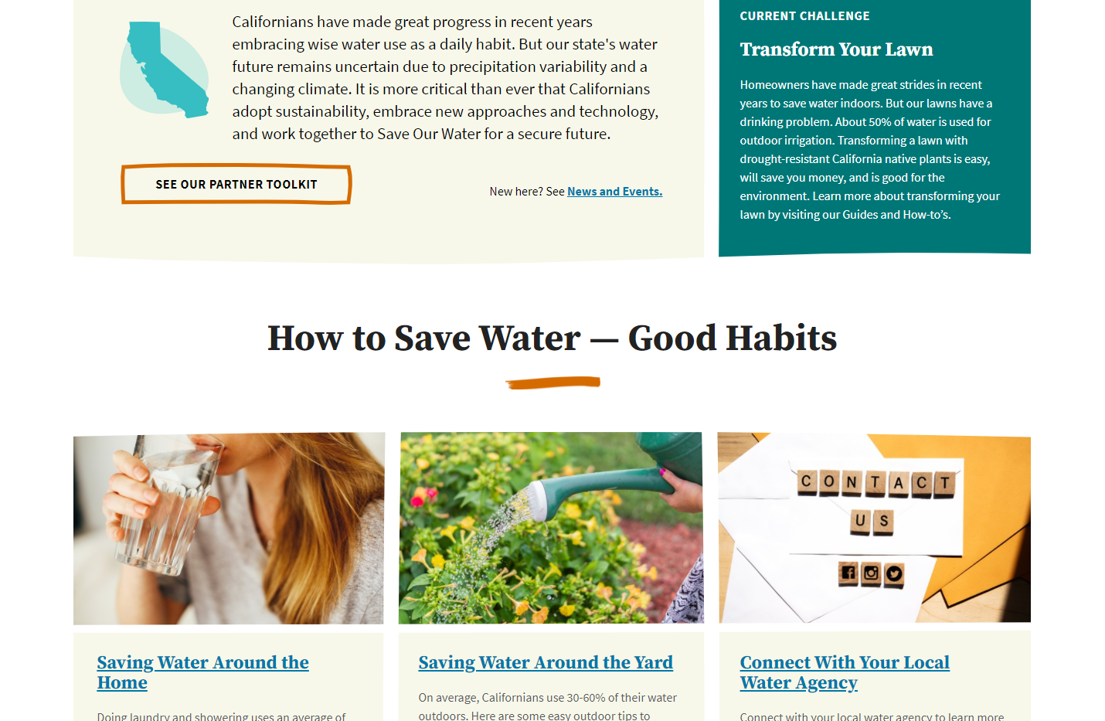
SaveOurWater.com (English & Spanish site)
SOW Website refreshed
Toolkit for water agencies, businesses, and other partners include:
English and Spanish
:15 and :30 produced radio PSAs
:15 Animation video PSA
Social Media graphics
Posters
Bill stuffers
Notes:
We provide that information through our save our water campaign which received additional funding in this year’s budget
The Governor has regularly directed people to our website which is available in English and Spanish
Tips for how Californians can save water like shorter showers, only doing full loads of dishes and laundry, and changing the way they irrigate their yards and properties.
There’s also Updated materials in the Partner Toolkit will soon be available for anyone to use – this includes PSAs social media graphics, posters, bill stuffers

Slide 7
Save Our Water Campaign
Notes:
Here’s an example of some of our Spring messaging where we focused on the message “every drop counts, use water wisely” to encourage residents to plant native and drought resistant plants in their yards to use less water.

Slide 8
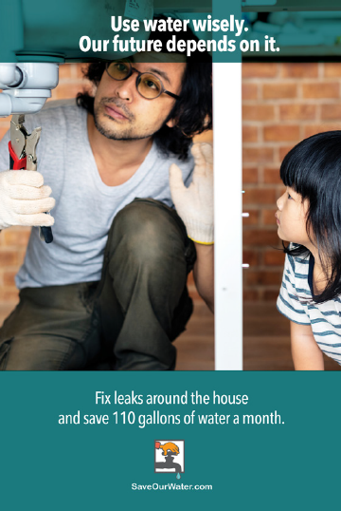
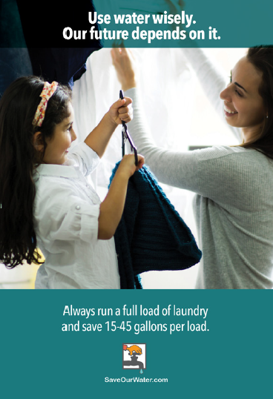
Save Our Water Campaign
Notes:
Here’s a few more examples from our spring campaign, focused on reducing water use in the home including using less water when brushing your teeth or doing laundry, and fixing leaky pipes.
These ads were done in English and Spanish.

Slide 9
Reporting Dry Water Supplies
Allows residents to report dry water supplies or wells
State and local agencies can track drought impacts
Mydrywatersupply.water.ca.gov
Notes:
In addition to conservation, we also need the public’s help reporting problems with water supply so the state can adequately track and respond
Mydrywatersupply.water.ca.gov allows residents to report dry wells or water supplies
State and local agencies can then track drought impacts
Site also provides some resources for residents – hoping to bolster that part of the web page in the near future
Also making it available in Spanish soon
We would greatly appreciate if the counties would promote this site, especially in regions that have a high number of private well users reliant on groundwater
We have sample social media messaging that I can share with the group

Slide 10
Technical Assistance Available
www.water.ca.gov/Work-With-Us/Technical-Assistance
https://water.ca.gov/Work-With-Us/Grants-And-Loans
Notes:
DWR also facilitates technical assistance and grant funding for local water agencies and water suppliers
We have two websites focused on available technical assistance and loans and grants
I’ve put the links here and will send them around after.
The recently passed budget provides hundreds of millions in grants that will be available
Pending the outcome of all the budget bills, DWR plans to engage counties regarding our new funding and small communities’ drought relief responsibilities:
Provide non-competitive grants to counties to develop countywide drought and water shortage contingency plans.
Update the drought and water shortage risk scoring for small systems and rural communities and make risk assessment results available to counties to prioritize their efforts.
Partner with counties to identify potential projects and communities needing help.
Counties may also apply for funding to implement drought emergency and resiliency related projects for their communities.
Counties and Groundwater Sustainability Agencies can submit emergency drought related projects in the interim through their DWR SGMA points of contact who in turn will forward to DWR Drought Program staff.
DWR will be providing more information on this once all the budget bills are finalized.

Slide 11
New Technologies
Airborne electromagnetic (AEM) surveys
Helicopter-based surveys of groundwater basins
Starting this month in several counties
Notes:
I’ll close with something interesting and cool…
One of the newer technologies that we’re deploying… we’re using an innovative, helicopter-based, geophysical technology called the airborne electromagnetic (AEM) method.
These aerial surveys will collect data on groundwater aquifer systems to provide a better understanding of the systems to support improved groundwater management and drought preparedness and response.
We’ll be doing surveys later this month in the Salinas Valley, Paso Robles and Cuyama Valley groundwater basins, which are within portions of Monterey, San Luis Obispo, Santa Barbara, Ventura, and Kern counties. We plan to send out a news release later today.
We’ll be conducting these surveys over the next several years.

Slide 12
Questions?

Slide 13
Follow us on social media
CADWR
CA_DWR
calwater
cadepartmentofwaterresources
Notes:
NEGATIVE SPACE
GOOD

