Slide 1
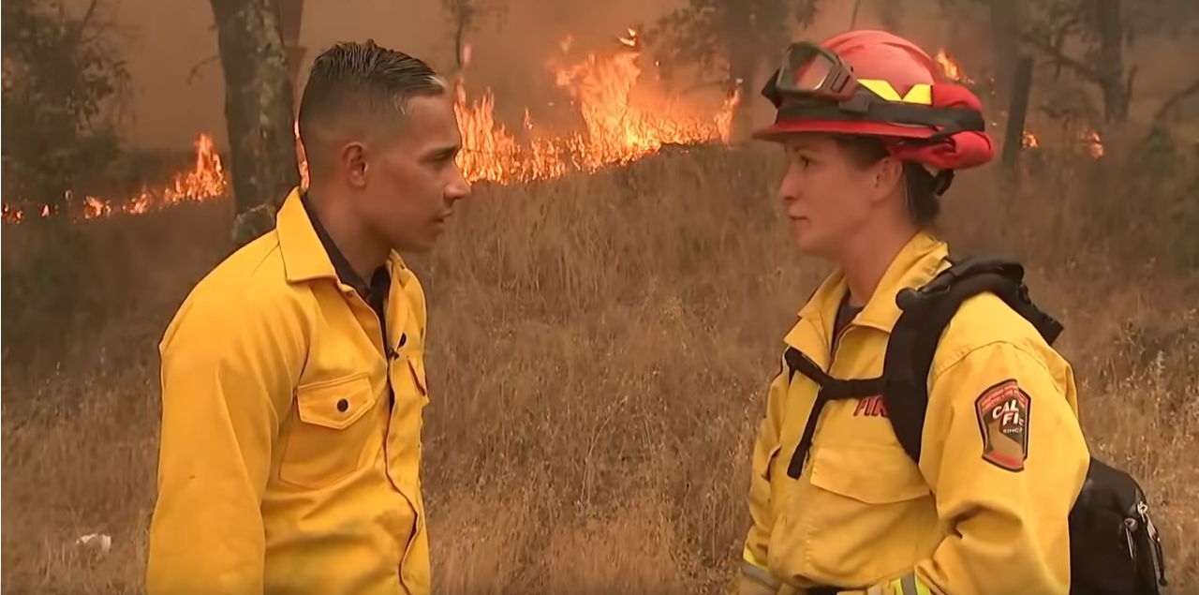
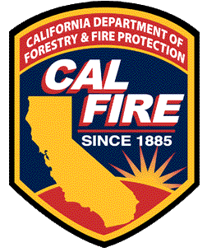
CAL FIRE
Communications Bureau

Slide 2
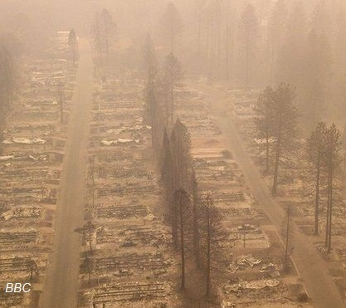
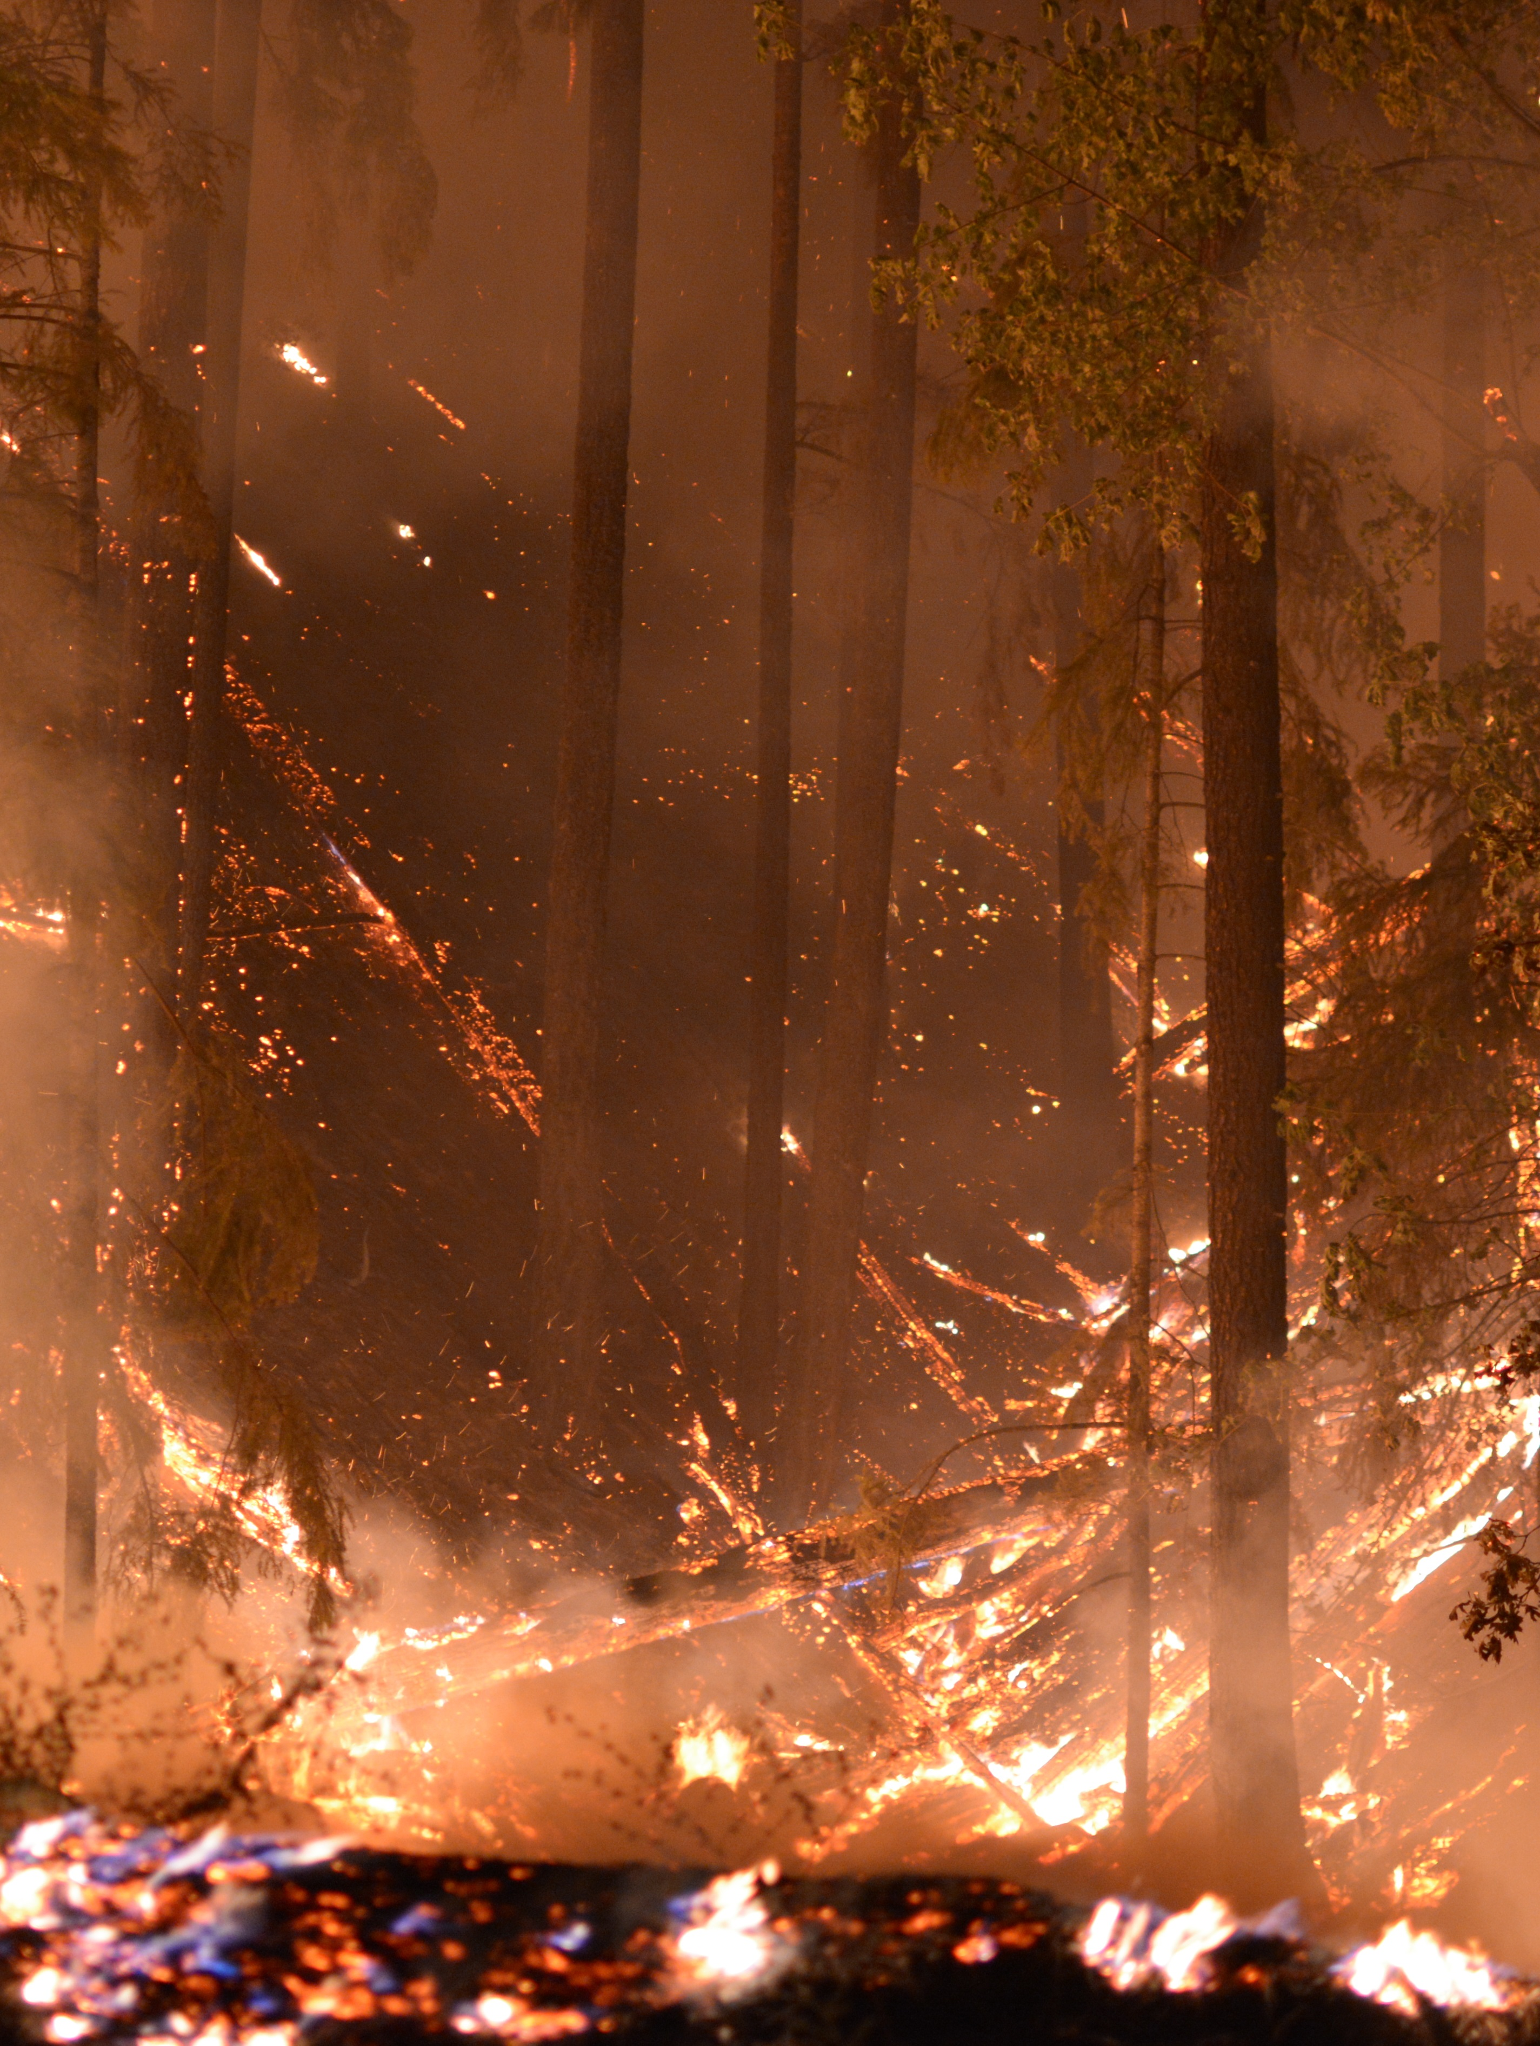
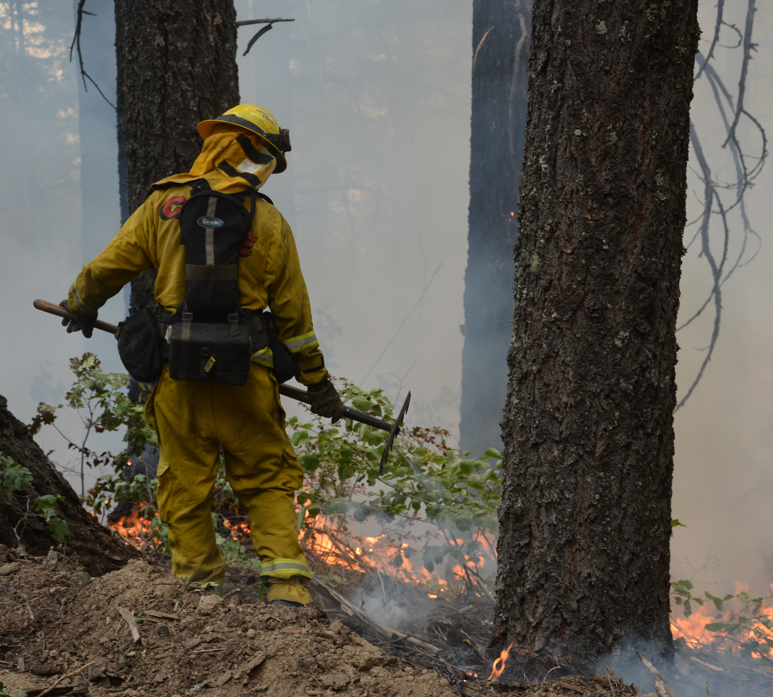
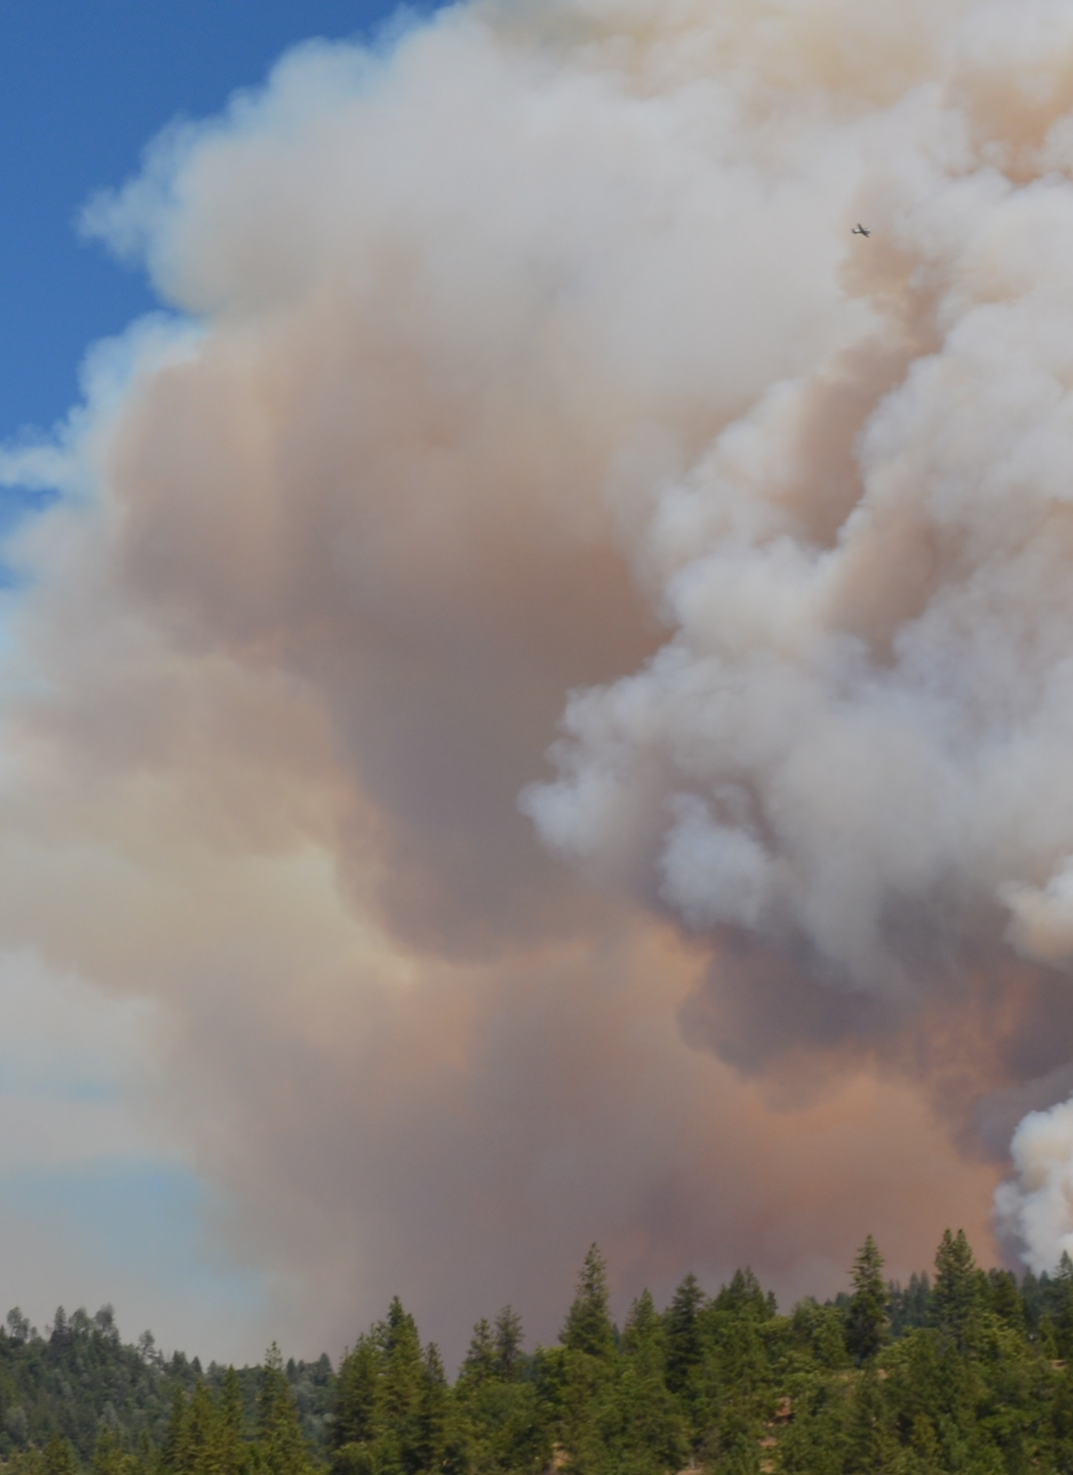
2020 by statewide numbers
Approx. 10,000 wildfires
Over 4.2m acres burned
Over 10.6K structures destroyed or damaged

Slide 3
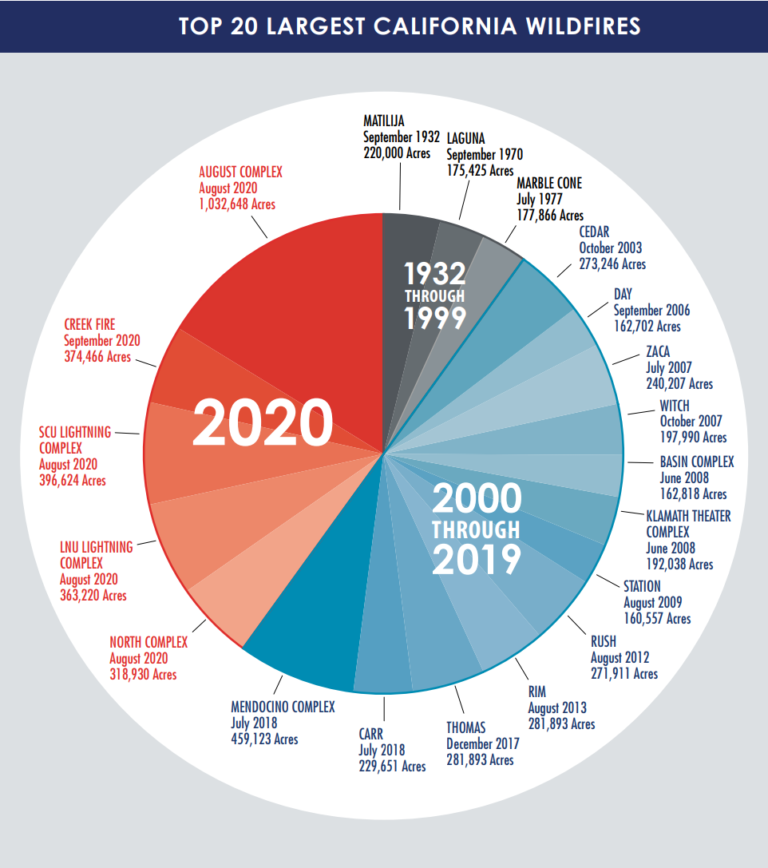
The fire Siege of 2020 included 5 of the 20 largest fires in California history
The 2020 August Complex was the largest fire in recorded history at over 1 million acres

Slide 4
2021 has shown an increase of 266% in acres burned from 2020 and an increase of 17% in total number of fires

Slide 5
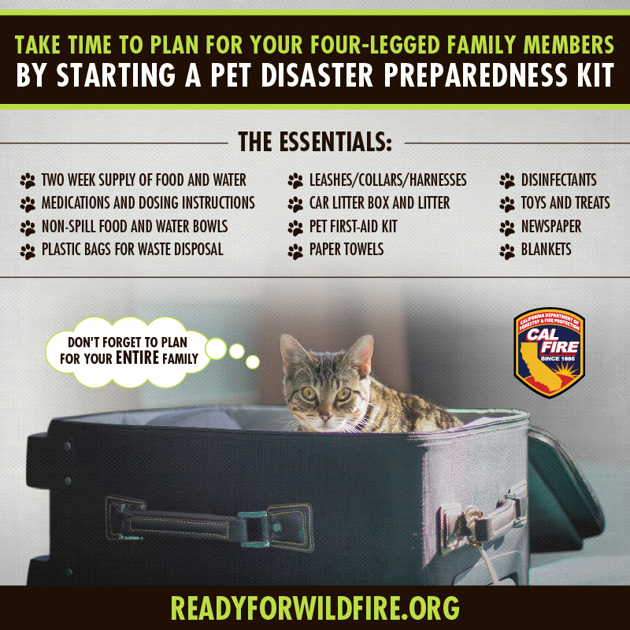
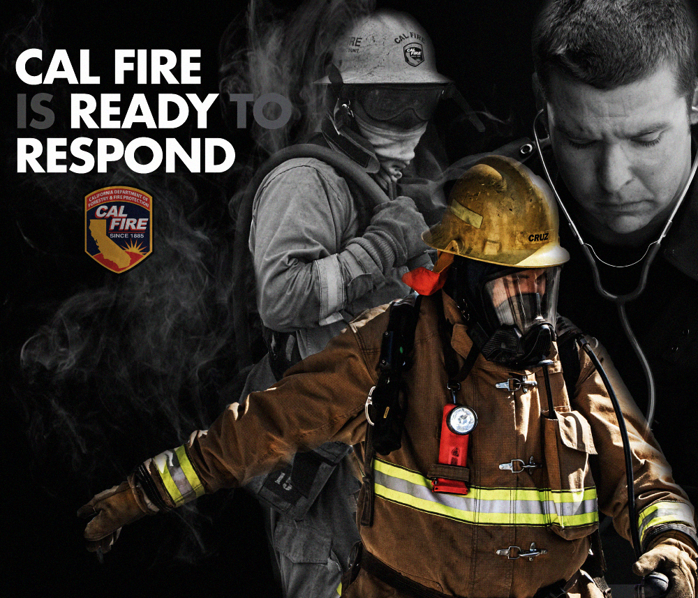
Messaging Priorities for 2021
March – May
Public and CAL FIRE preparedness
June – November
Prevention
December – February
In home safety

Slide 6
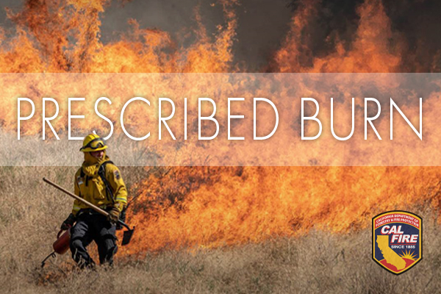
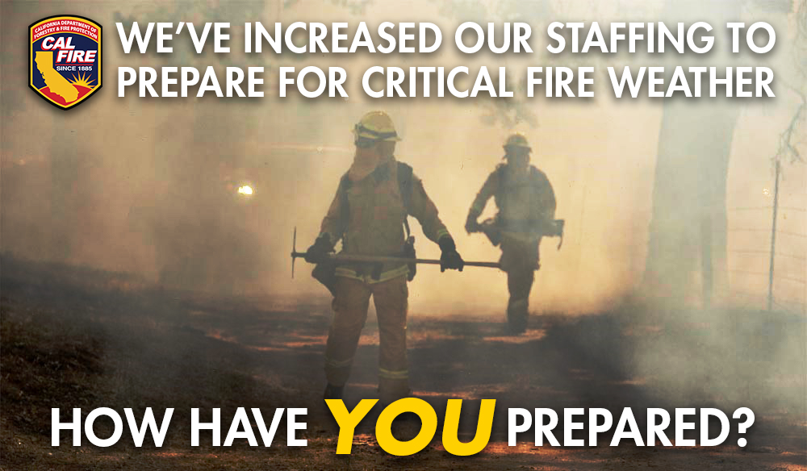
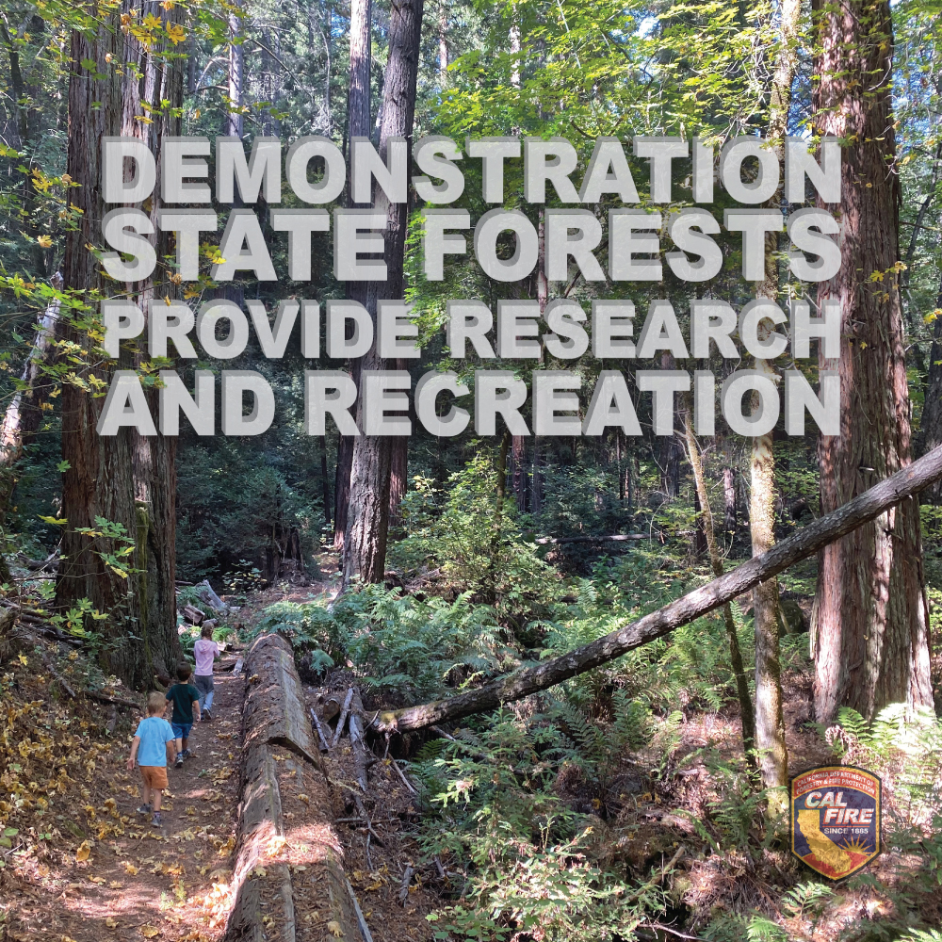
Special Messaging
Communitywide fuel preparation efforts
Statewide fuel reduction efforts
Emergency response capabilities
Firehawks
Increased staffing
Cooperative efforts
Resources management
Demonstration forests
Timber harvest

Slide 7
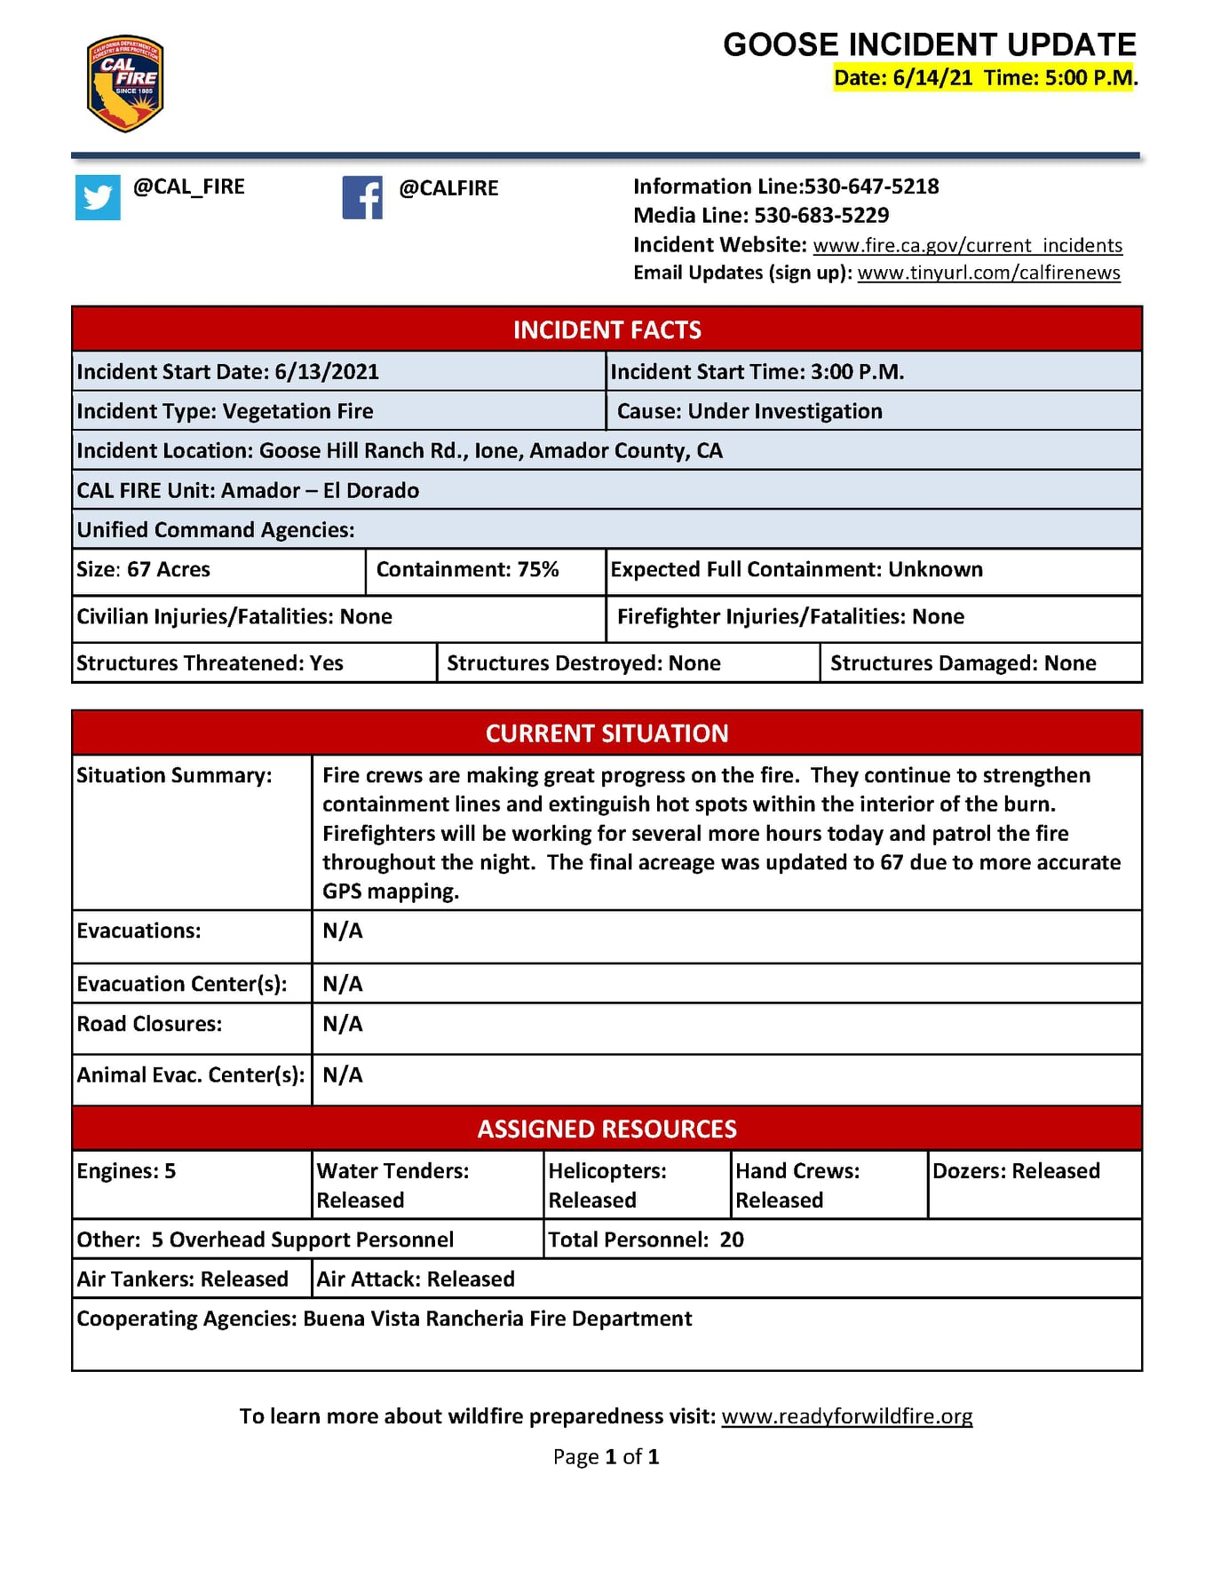
Information for California
Incident information/updates
Education and fire prevention
Department fact sheets
Internal and external statistics
Focused informational campaigns
Departmental news releases
Resource Management

Slide 8
How we reach our customers
Twitter
Facebook
Instagram
Constant Contact
Flickr
Pinterest
YouTube
Vimeo
CAL FIRE app
Fire.ca.gov

Slide 9
Socially Connected
Twitter 430k followers
Facebook 550k followers
Instagram 176k followers
YouTube 16k subscribers
Flickr over 8k images
*Primary CAL FIRE accounts. Local Units maintain their own profiles.

Slide 10
2020 Fire Siege Analytics Aug 15-Nov 4

