Slide 1
Infrastructure investments to spur climate-friendly housing
SaCRAMENTO AREA COUNCIL OF GOVERNMENTS

Slide 2
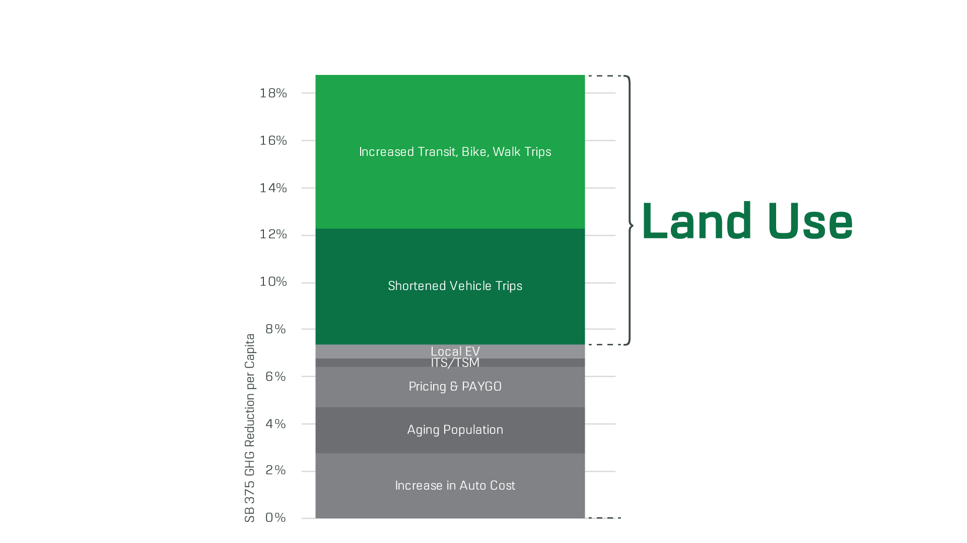
Key Factors Contributing to 19% GHG Reduction

Slide 3
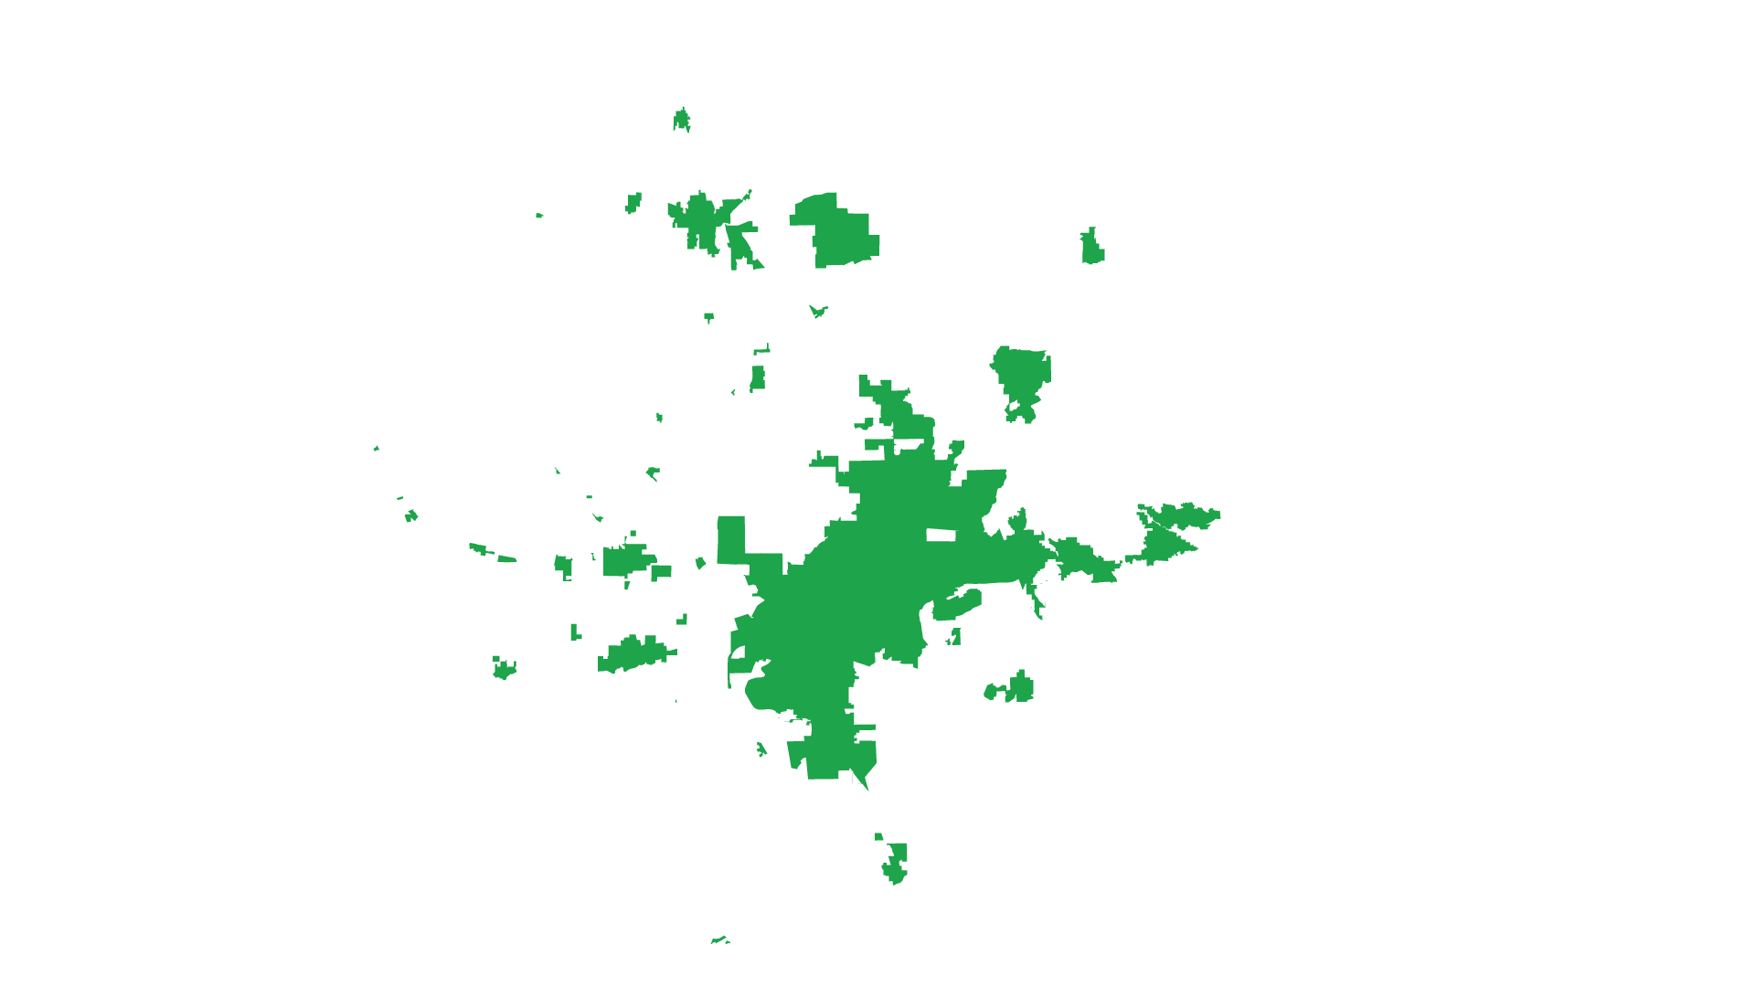
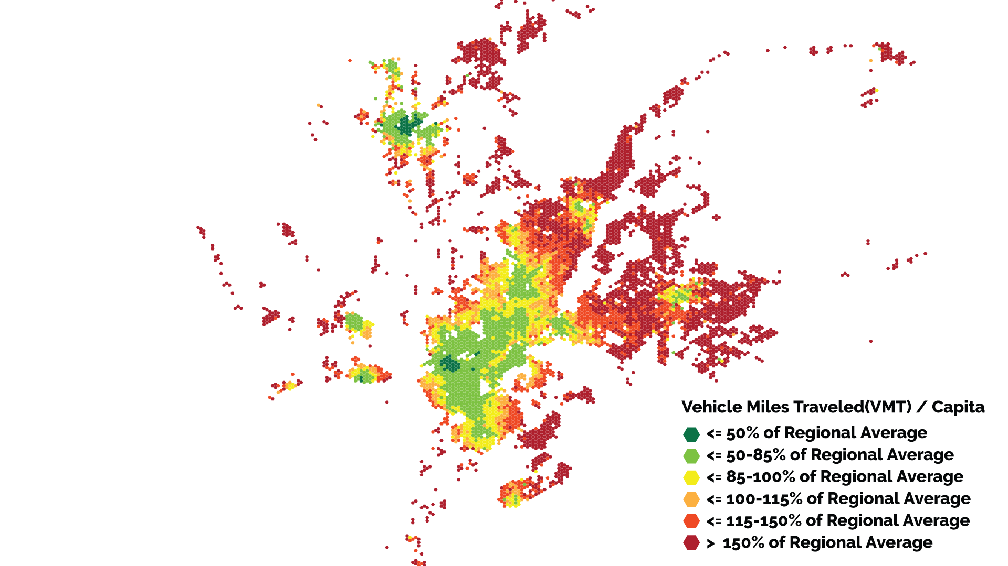
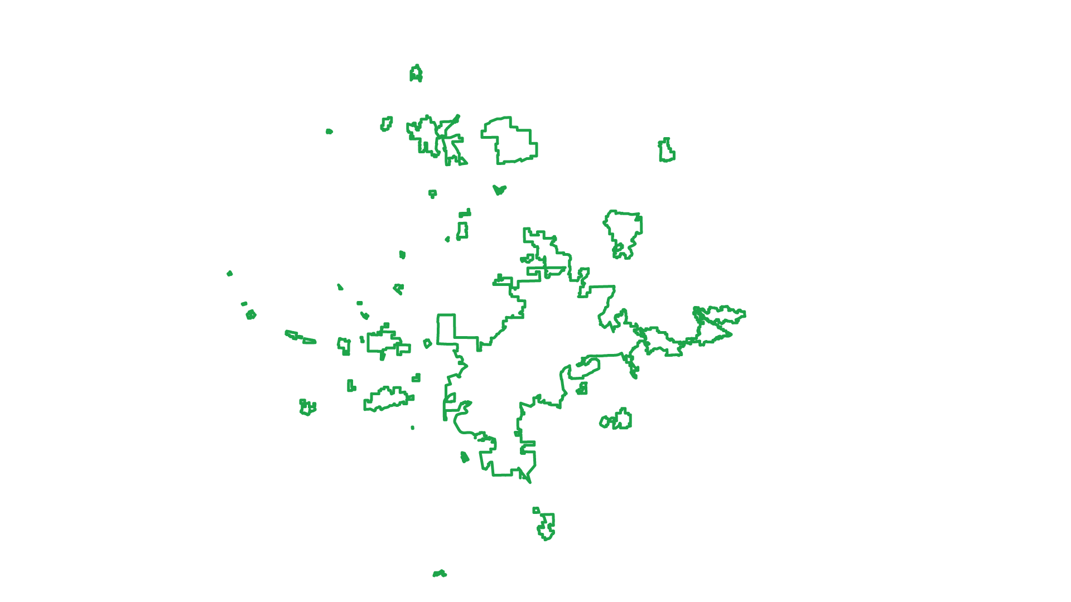
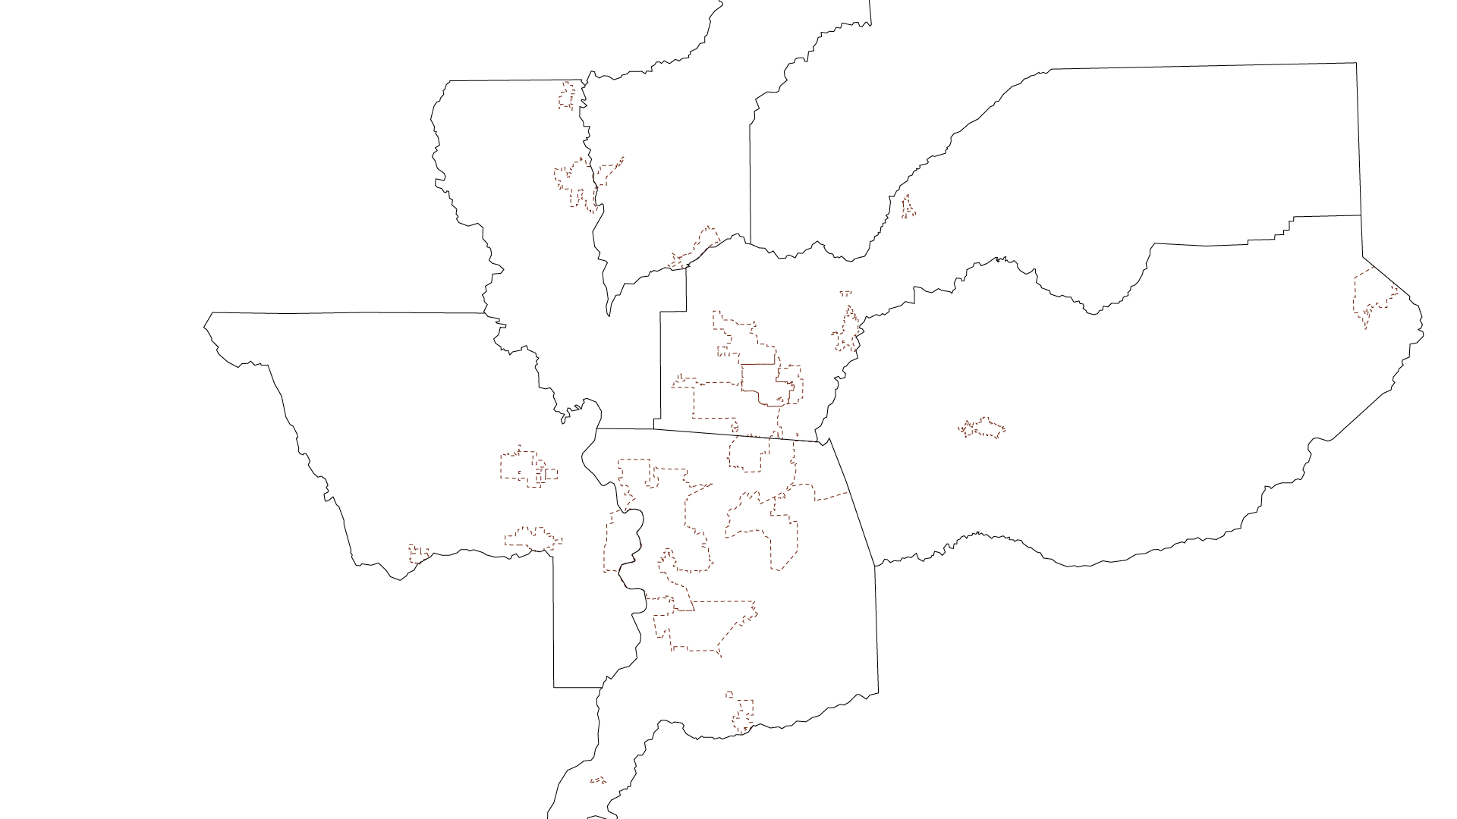
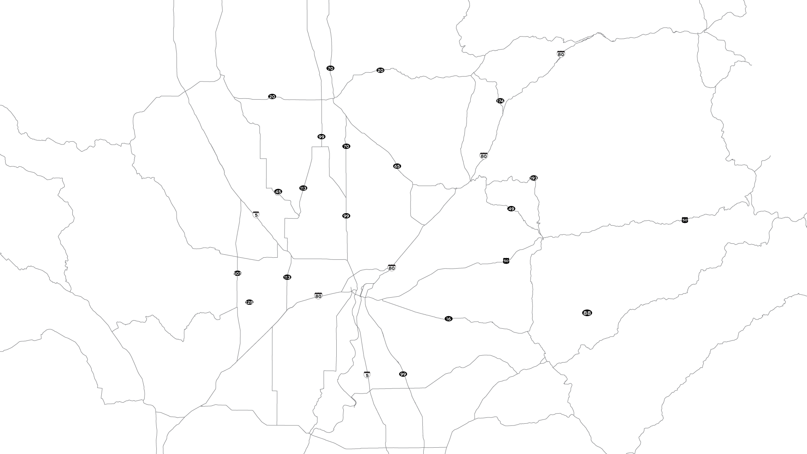
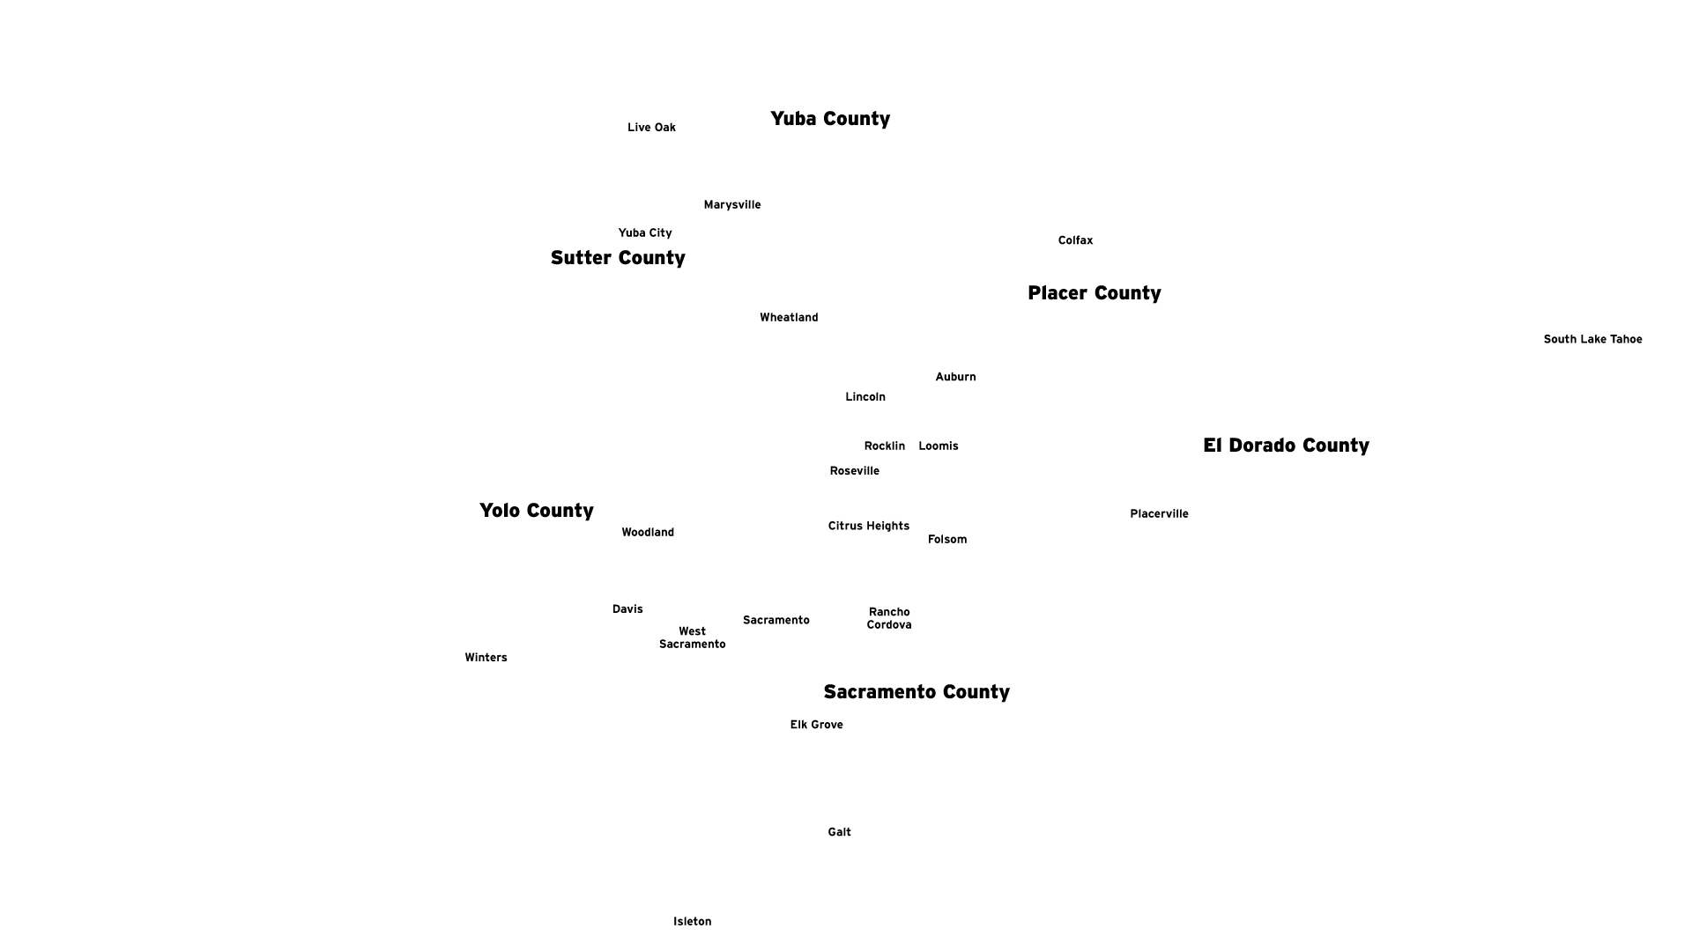
2040

Slide 4
Barriers to development in infill areas in the Sacramento region
Cost and Risk
Water/sewer upgrades needed
Construction costs
Transportation infrastructure/ safety
Local opposition/ CEQA
Zoning/parking requirements

Slide 5
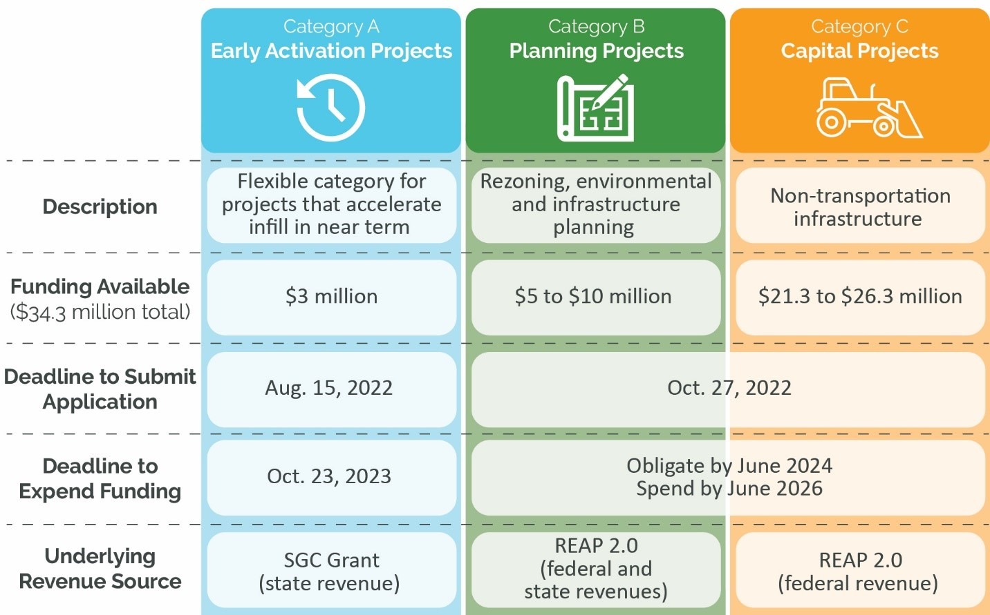
Green Means Go
Funding Categories

Slide 7
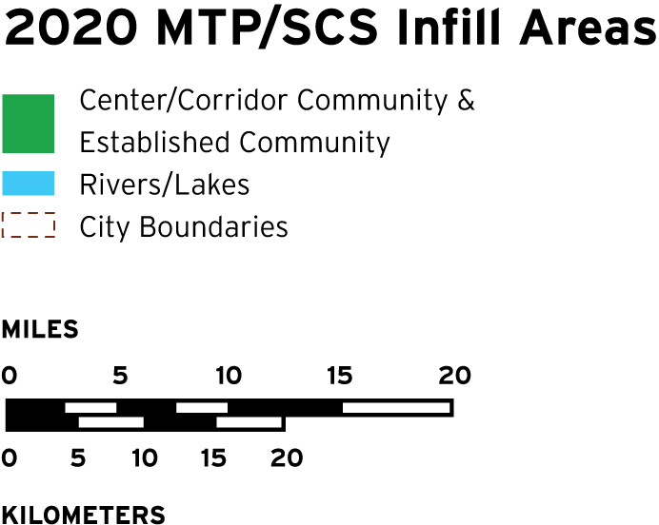
Example Areas for Investment

Slide 8
Local
A Regional Partnership
SACOG
State
Update zoning codes and local ordinances
Streamline permitting process
Lower or waive impact fees
Fund corridor planning
Fund local transportation plans and projects in “Green Zones”
Support for Civic Lab smart mobility and commercial corridor project implementation
2020 Commercial Corridors Task Force
Create Housing Toolkit
Add a regional component to state funding programs
Fund programs to accelerate infill development
Examples for illustrative purposes only

Slide 9
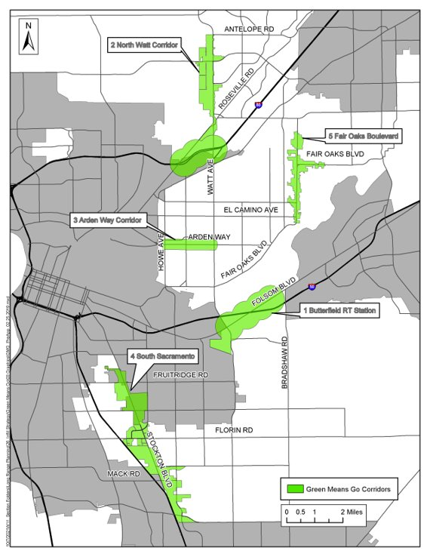
Sacramento County's Five Green Zones
Board adopted Green Zones in November 2020
Planning staff developed Green Zones based on known infill priorities, Environmental Justice communities, and previous planning work completed.
Intent: Focus investment and prioritization efforts
Notes:
(Sac County)
Perspective from Sacramento County (Sac County)
Focus on North Watt
2012 Corridor Plan, yet that plan’s vision not materializing
Designated as Green Zone
Environmental Justice area
Whatever else County staff want to add re N Watt

Slide 10
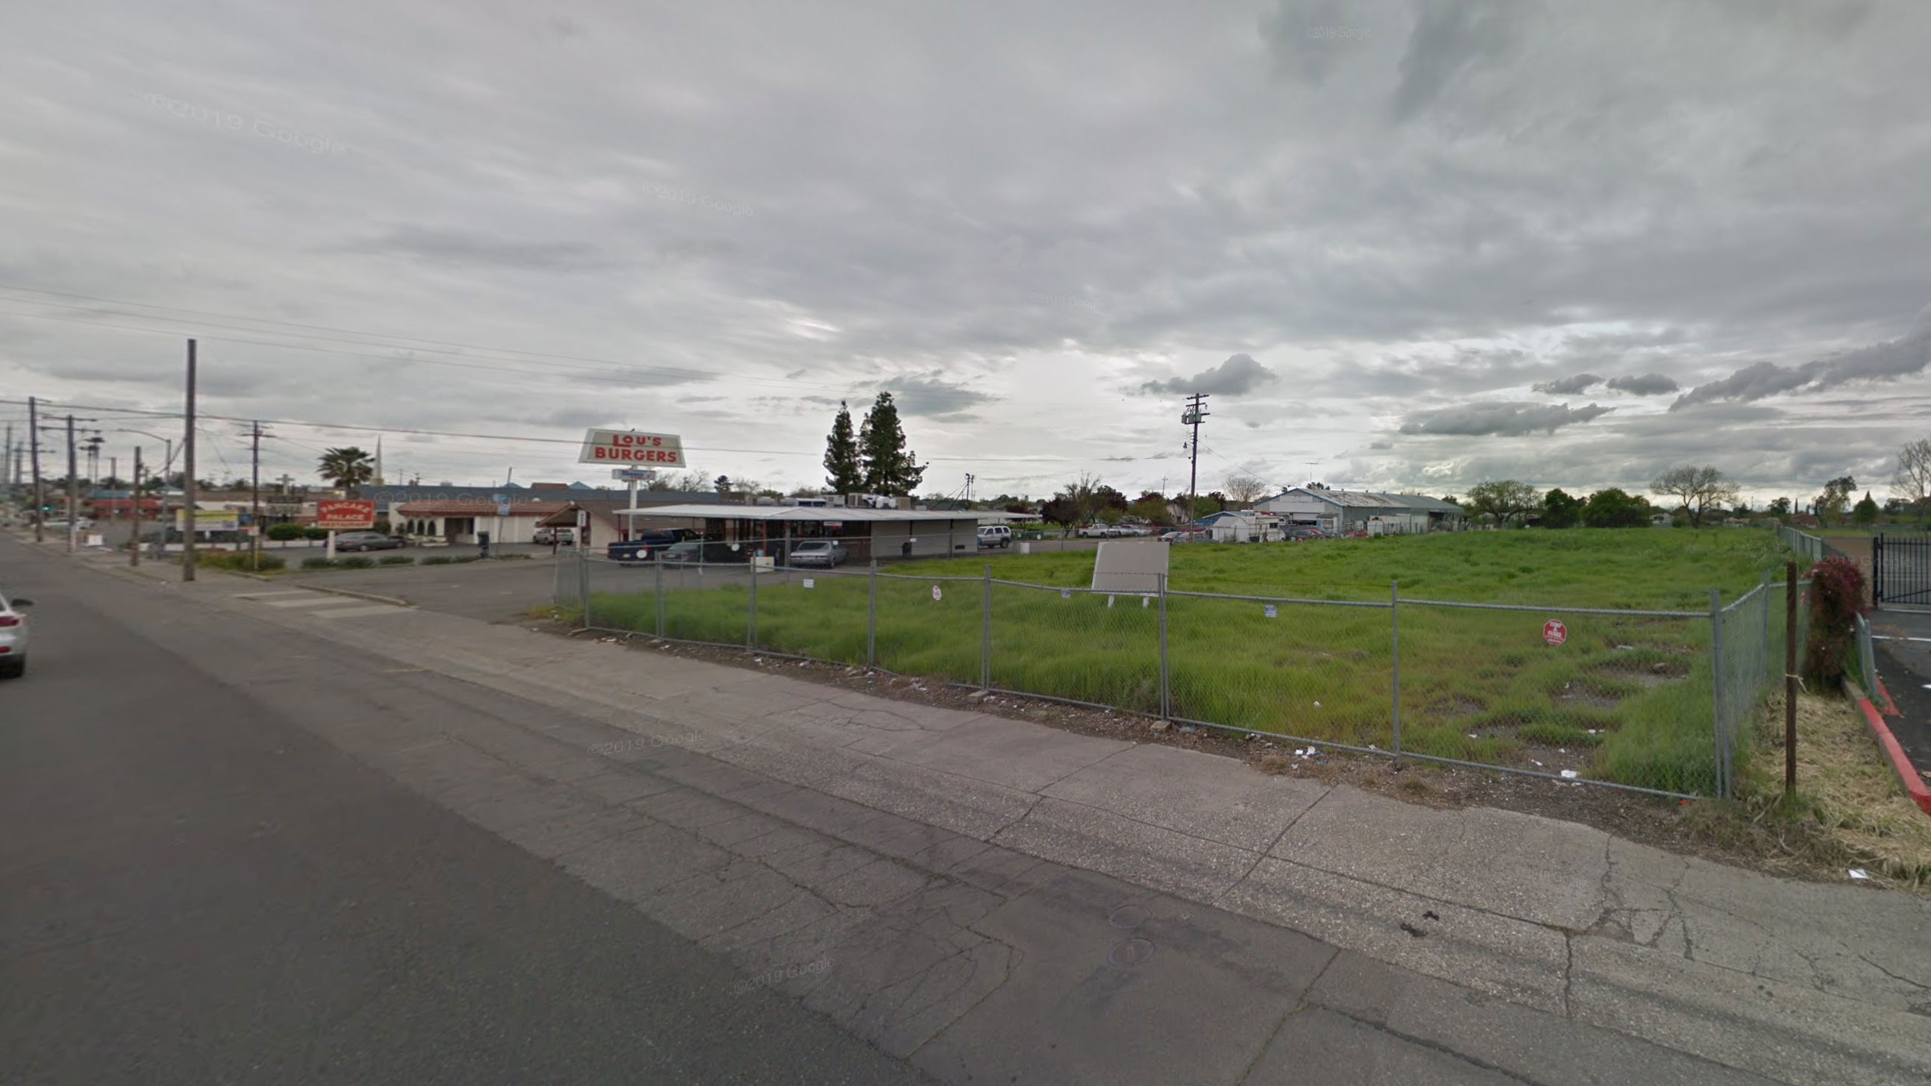
Example - North Watt Funding Needs
Sewer infrastructure resizing
Property acquisition
Safe closure of wells and septic systems

