Slide 1






Emergency Management, Public Health, and Public Safety Perspective on Homelessness

Slide 2
Los Angeles County
Homeless Initiative Unit
Ashley Oh

Slide 3

Preventing and Combating Homelessness
Inland Empire Regional Meeting
California State Association of Counties
March 29, 2018
Ashlee Oh

Slide 4



Homeless Crisis
  LA County has a major homeless crisis, which is further exacerbated by a housing affordability crisis.
  Nearly 58,000 people experienced homelessness on a given night in 2017.
  Nearly ¾ of homeless people are unsheltered.
  In the Los Angeles Metro Area, as of 2015, 57% of renters were cost-burdened (paying more than 30% of income for housing) and 31% of renters were severely cost-burdened (paying more than 50% of income for housing).

Slide 5
County Homeless Initiative
Seizing the moment: Historic opportunity to combat homelessness throughout LA County
  Launched on August 17, 2015
  Initial Goal: Develop a set of recommended County strategies to combat homelessness, including strategies in which cities can participate
  Process: Inclusive and collaborative planning process with participation from 25 County departments, 30 cities, and over 100 community organizations
18
Policy Summits
4
Focus Groups with Homeless
200
Public Comments
2
Community Meetings

Slide 6
Homeless Initiative Strategies
Strategies fall into six inter-related categories:
Prevent Homelessness
Subsidize Housing
Increase Income
Provide Case Management
Create a Coordinated System
Increase Affordable/Homeless Housing.

Slide 7
Measure H
¼ cent County Sales tax that will generate an estimated $355 million annually for 10 years dedicated to prevent and combat homelessness and is enabling the County to fully implement and scale up the strategies.
Projected to help 45,000 families and individuals move from homelessness to permanent housing, and enable 30,000 more to avoid becoming homeless – within the first five years.
Board ordinance places Measure H on Mar. 7, 2017 countywide ballot to prevent and combat homelessness
Passage of Measure H with 69.34% voter approval
12/6/2016
2/7/2017
3/7/2017
6/13/2017
Board directs CEO to conduct a Measure H revenue planning process to develop funding recommendations for FY 17/18 – FY 19/20
Board approves final funding recommendations for FY 17/18 and tentative recommendations for FY 18/19 and 19/20

Slide 8
First Six Months of Measure H
50 public-private stakeholder consensus on Measure H funding allocations
Measure H implementation moving expeditiously
Incredible synergy between providers, County departments, cities, Councils of Governments, faith organizations, and Los Angeles Homeless Services Authority (LAHSA, Continuum of Care)

Slide 9

Key Measure H Outcomes to Date
July - December 2017:
7,297 individuals entered crisis, bridge, and interim housing including 811 individuals discharged from institutions
Approximately 3,350 homeless families and individuals secured permanent housing through specific HI strategies including:
1,385 rapid re-housing participants
1,064 individuals from emergency shelter
483 disabled adults pursuing SSI were housed

Slide 10
Key Measure H Outcomes to Date
4,038 individuals have been engaged by Outreach Teams
3,143 youth were assessed using Next Step Tool
4,261 disabled individuals were assisted with applications for SSI and Veterans Disability Benefits
2,556 inmates received jail in-reach services

Slide 11
Key Measure H Outcomes to Date
1,280 clients were linked to new Intensive Care Management Services
658 families received prevention services
948 deputies and sergeants were participated in First Responders Training
(Data is from Oct. 2016 - Dec. 2017)

Slide 12
Community Engagement
Changing the community paradigm and perception to promote siting of supportive housing
A campaign launched on 3/9/18 to communicate, engage, and activate people across the County to build the momentum we need to make real progress towards ending homelessness.

Slide 13



Coordination
Policy, funding and practice implications of effective inter-agency and intra-agency coordination to prevent and combat homelessness:
Multi-stakeholder platform for addressing homelessness strategically with an integrated vision and via comprehensive effort
Strengthened coordination and integration across response platforms
Improved outcomes
Promotion of the efficient use of public funds

Slide 14
Collaboration is Key
Homelessness is a regional problem that can only be effectively addressed with a sustained commitment to action by the County, cities, community providers, business community, faith organizations and individuals across the County.

Slide 15

Kenneth Hahn Hall of Administration
500 West Temple Street, Room 493
Los Angeles, CA 90012
homelessinitiative@lacounty.gov
@CountyHomelessInitiative
FOR UP TO DATE INFORMATION VISIT US AT:
HTTP://HOMELESS.LACOUNTY.GOV

Slide 16
Los Angeles County
Office of Emergency Management
Jeffery Reeb

Slide 17

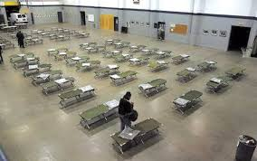
Los Angeles County AWSP
Notes:
Los Angeles County and City fund a variety of services to address homelessness. T
This is lead by the Los Angeles Homeless Services Authority which provides a broad spectrum of services for people experiencing homelessness.
They year round shelters: open every day
Seasonal shelters opened during the coldest wettest months of the winter
The question was how could we add surge capacity for the worst days to these existing Programs?

Slide 18
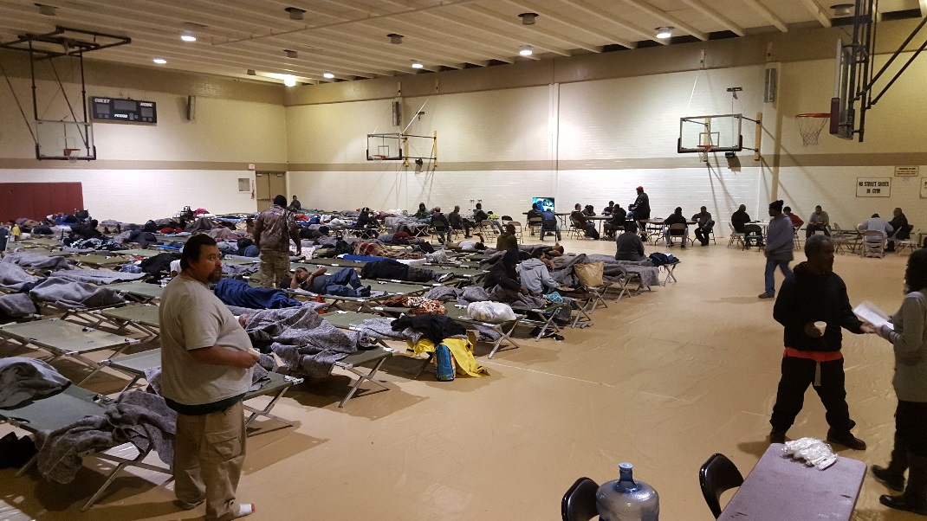
Shelter Surge Capacity
Add additional facilities for adverse weather
Establish a dynamic program
Weather forecasting was critical to success
Notes:
So we did what we almost always do when facing a new emerging emergency management planning need we formed a Task Force consisting of the various stakeholders that could bring a capability to this fight
Los Angeles County offered up County Parks and Recreation gymnasiums that could be converted into temporary shelters.
LAHSA pre-placed cots blankets etc at portable storage containers at these sites and arranged professional staff that could be called upon.
So we had the mechanism in place, now we needed to decide when would we need the surge capacity.

Slide 19
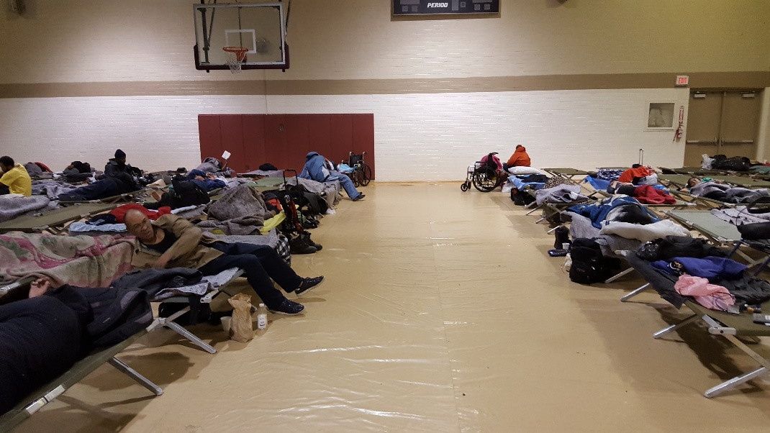
Augmented Shelter Sites
Dependent on the Winter Shelter Backbone
Required 24 hour activation lead time
Balance fiscal responsibility with meeting needs

Slide 20

AWS Activation Criteria
(NWS)1 inch of rain in 24 hours
3 or more consecutive days of ¼ inch of rain, temperatures at or below 50 degrees
County Health Officer issues a Cold Weather Alert (3 X <50 F, Wind-chill <32 F
NWS issues a flood watch or warning
Notes:
The criteria we used were developed in collaboration with the NMS, homelessness experts and our Department of Public works.
We closely watched shelter utilization rates in the existing winter shelter programs and if reached these thresholds we would bring on additional sites.
1 inch of precipitation in 14 hours
Three or more days of a ¼’ of precipitation or more each day
If the Health Officer issues a Cold Weather Alerts
If the NWS issued a Flood Watch or Warning
Address not only the long term environmental effects of exposure but also the physical risks of drowning in our riverbeds and flood control features.

Slide 21
Keys To Success
Public Non-Profit Partnership
  LACO, NWS, LAHSA
Criteria based decision making
Senior leadership commitment

Slide 22
Los Angeles County
Department of Public Health
Dr. Prabhu Gounder

Slide 23
Public Health Response to Hepatitis A Outbreak Among Homeless People in
Los Angeles County
Prabhu Gounder, MD, MPH
Medical Director, Viral Hepatitis Unit
Acute Communicable Diseases Control Program

Slide 24

What is Hepatitis A?
Virus that damages liver
Symptoms
  Nausea, vomiting
  Abdominal pain
  Jaundice
Fecal-oral transmission
  Secreted in stool
  Ingestion of contaminated food or water
Propagated by poor sanitation

Slide 25
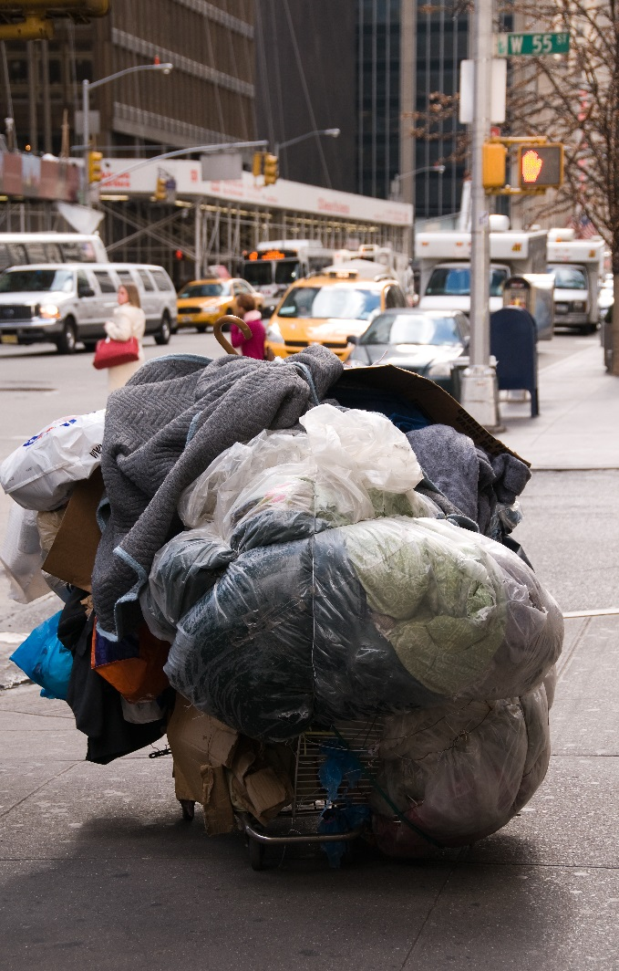
Why is hepatitis A challenging to control?
Highly contagious
Infected person contagious 14 days before symptom onset
Can persist on environmental surfaces for months
Resistant to killing by many common disinfection methods
Notes:
Item 87798497

Slide 26

Hepatitis A Outbreak in LA County

Slide 27


LA County Department of Public Health (DPH) Outbreak Control Strategy
Case detection and containment
Vaccination
Improve sanitation
Provide education and information
Required coordination and partnerships with internal and external partners

Slide 28
Case Detection and Containment Strategies
Case detection
  Automatic lab reporting of positive hepatitis A tests
  Requested providers immediately report suspected homeless cases prior to discharge
Created 24/7 on-call Rapid Response Teams
  Canvased streets vicinity of new case to rapidly identify and treat people at risk
    Treatment <14 days can prevent infection
  Public health nurses and doctors
  Partnered with homeless agencies and first-responders as needed

Slide 29
Vaccinated People at Risk From Outbreak
Vaccine is best tool for preventing new infections
DPH clinics offered free vaccine to at risk people
Partnered with street outreach teams that targeted homeless people to offer vaccine
Promoted vaccine to people with close frequent contact with homeless people (e.g., first-responders, sanitation workers, and food handlers who serve homeless)
Engaged health plans and providers to encourage vaccinating at-risk people

Slide 30
Sanitation Improvement
DPH Environmental Health (EH) partnered with Los Angeles Homeless Service Authority (LAHSA)
  Inspected homeless shelters
  Provided a toolkit with template resources and policies on improving sanitation
DPH EH, LASHA and Department of Public Works
  Assessed availability hygiene facilities at >50 homeless encampments
  Partnered with high risk cities to develop city-level plans to increase access to hygiene facilities
  Deployed toilets, showers, handwashing stations to LA County unincorporated areas

Slide 31
Educated Public and Key Stakeholders
Engaged 17 distinct stakeholder groups including city leaders, homeless service providers, healthcare providers, and first responders
Conducted >500 in-person educational trainings at various community settings
Created a toll-free hotline as a primary source for answering questions from general public
Public awareness campaign promote awareness, hygiene, and vaccination

Slide 32
Los Angeles County
Sheriff’s Department
Lieutenant Geff Deedrick

Slide 33



Los Angeles County Sheriff’s Department
Homeless Outreach Services Team
Homeless Encampment Protocol
Lieutenant Geff Deedrick
LASD-Community Partnerships Bureau

Slide 34
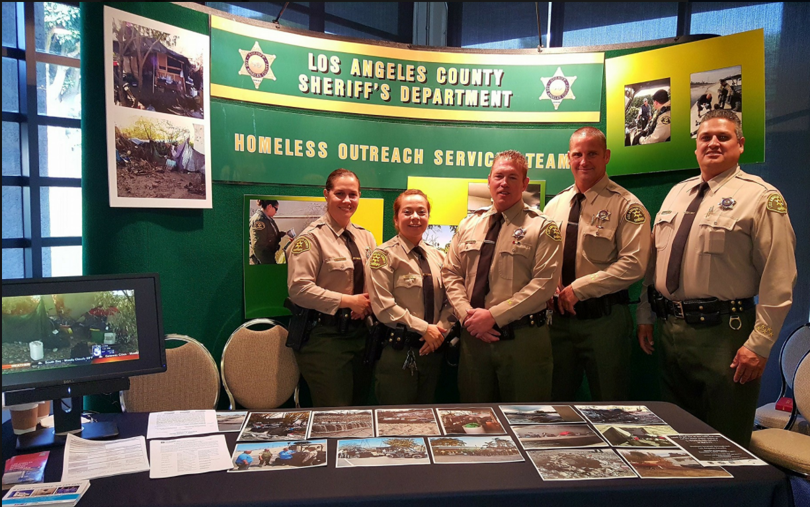
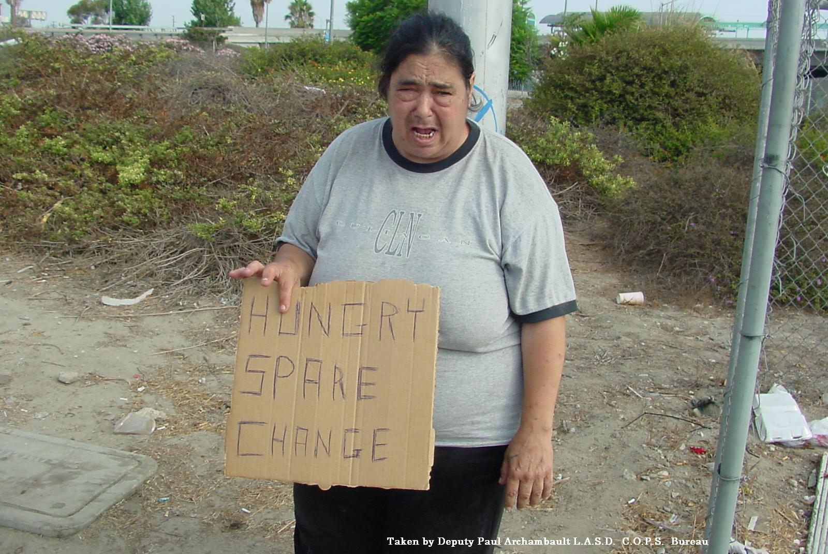
HOST

Slide 35
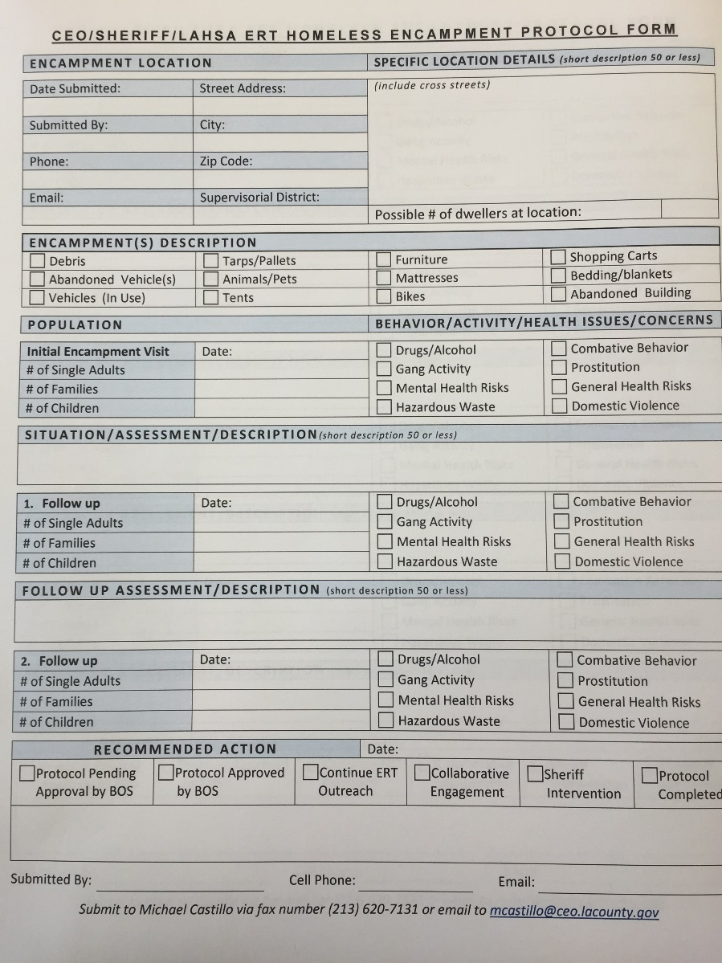
Homeless Encampment Protocol
To secure resources to enhance outreach efforts and social-service related issues at sites.
Addressing homeless populations/areas can monopolize field units time and efforts.

Slide 36
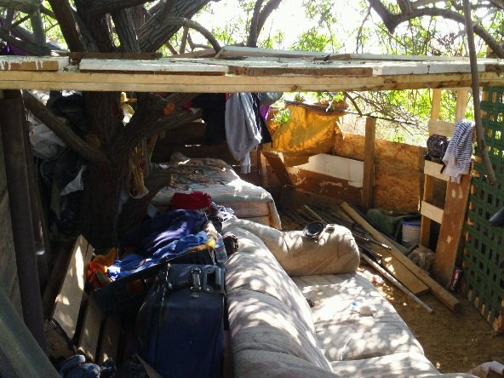
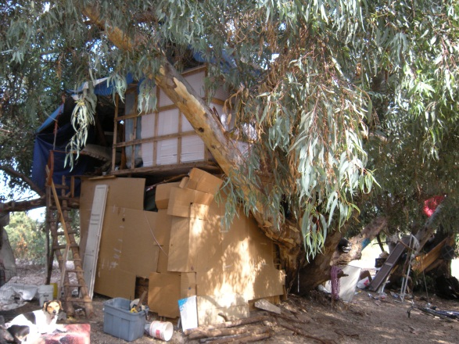
Definition
For the purpose of this protocol, a “Significant Homeless Encampment” is a location involving five or more homeless persons where one or more of the following conditions exist:
Homeless individuals routinely gather
Homeless individuals have established residency
Homeless individuals have constructed forms of shelter and/or dwellings
Homeless individuals are collecting or storing personal, abandoned or other type of property

Slide 37
Pre Storm Coordination
Ongoing outreach and engagement in encampments emphasizing safety.
Encampments are photographed with geocoded information and mapped.
Coordination with Sheriff Stations which have waterways within their jurisdiction.
Coordination with other Los Angeles County Departments prior to the weather event (OEM, DPW, Flood Control).

Slide 38
During Adverse Weather
LASD Homeless Outreach Services Team deploys utilizing off road vehicles.
Ongoing coordination with Sheriff Stations to conduct patrol checks in the waterways.
Communication with Office of Emergency Management, Flood Control and Department of Public Works

Slide 39
LASD First Responder Training
There are 6 modules of instruction, all of which are supported by a scenario-based video where discussion follows:
Understanding the Homeless Population – Who can be homeless
Three Stages of Homelessness – Transitional, episodic, chronic
Leveraging Available Resources – Law enforcement is not the solution.

Slide 40
Training Modules
Approach & Contact – Best practices for interacting with those who suffer from a mental illness & are homeless
Enforcement & Collaboration – Be the collaborative bridge, familiarize yourself with available resources
Legal Considerations & Potential Liabilities – Always be guided by the civil rights of others and the law, service providers are the best solution

Slide 41
Los Angeles County
Fire Department
Deputy Chief John Todd

Slide 42

LOS ANGELES COUNTY
FIRE DEPARTMENT
HOMELESS OUTREACH
Deputy Chief John Todd

Slide 43
LOS ANGELES COUNTY FIRE DEPARTMENT
HOMELESS OUTREACH
Homeless Shelters
  Change of use of Existing Buildings
    Alarms
    Exits
    Fire Sprinklers
    Fire Watch
  Faith Based Organizations/Charities
    Working with groups that want to help
    Cannot compromise occupant safety

Slide 44
LOS ANGELES COUNTY FIRE DEPARTMENT
HOMELESS OUTREACH
EMS Response
  Limited to Date
  Plan to train all First Responders
  Constrained by requirement that patients must be transported to the ER
AB 1795 – Assembly Member Gipson
  Would allow EMS transport to the appropriate facility
  Has support from the Board of Supervisors

Slide 45
LOS ANGELES COUNTY FIRE DEPARTMENT
HOMELESS OUTREACH
Fire Prevention in Homeless Encampments
  Not a new phenomenon (Kinneloa Fire of 1993)
  City of Los Angeles – Fires in Urban Areas
  Skirball Fire (December 6, 2017)
  Fire Weather Watches and Red Flag Warnings
Future Fire Department Efforts
  Location of Homeless Camps
  Force Multiplier – Firefighters and Department Volunteers paired up with LAHSA Outreach Teams

