Slide 1
Repealing the ACA: Effects on Counties
@CSAC_Counties
#ACACounties

Slide 2
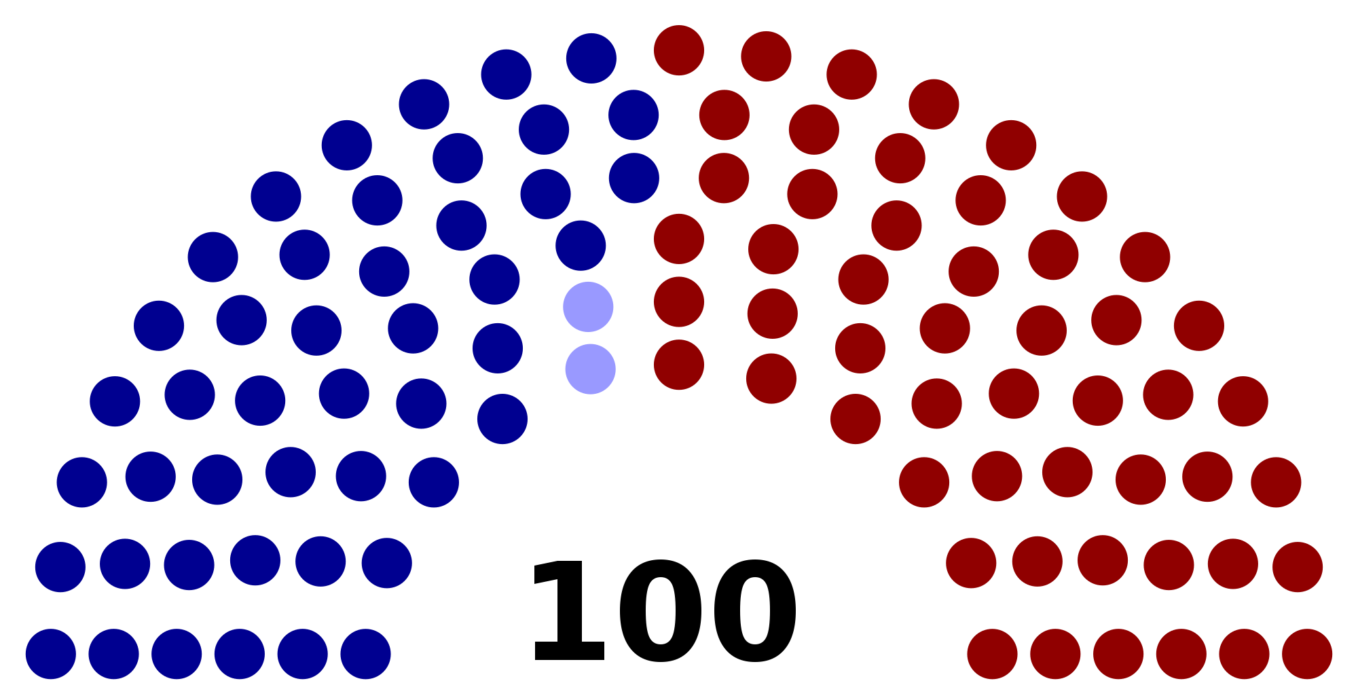
46 – D 2 – I 52 – R
United States Senate

Slide 3
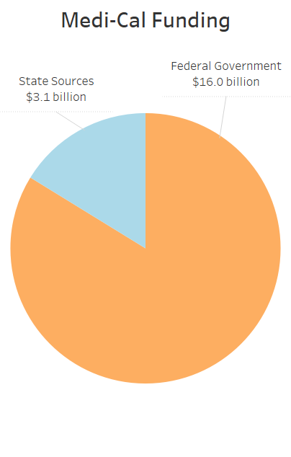
83.8 percent of Medi-Cal is funded by the federal government

Slide 4
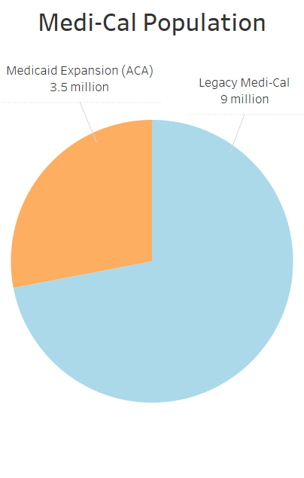
28.5 percent of Medi-Cal caseload is due to the Affordable Care Act

Slide 5
Speakers
Farrah McDaid Ting, CSAC
fmcdaid@counties.org
@CSAC_HHS
Michelle Gibbons, CHEAC
mgibbons@cheac.org
Tom Joseph, Waterman & Associates
tj@wafed.com

