Slide 1
Annual Expenditure Report – Online Troubleshooting Local Streets and Roads Funding Program
September 17, 2018
Alicia Sequeira Smith, California Transportation Commission
Local Streets and Roads Program Manager

Slide 2
Webinar Objectives
Background
Annual Project Expenditure Reporting Deadline
Reporting Criteria
Troubleshooting
Q & A
Additional Resources

Slide 3
Local Streets and Roads Funding Program – Annual Reporting Requirements
Cities and Counties are required to annually submit to the Commission the following information:
A proposed project list which contains the following for each project:
Proposed Project Description
Proposed Location
Proposed Schedule for Completion
Estimated Useful Life of the Improvement
A project expenditure report which contains the following for in-progress and complete projects:
Project Description and Location
Project Estimated/Completion Date
RMRA Funds Expended on the Project
Estimated Useful Life of the Improvement
Per Streets and Highways Code Sections 2030-2037 &
Current Local Streets and Roads Funding Program Reporting Guidelines.
Notes:
To promote transparency and accountability within the program funding, annual project reporting through the submittal of the proposed project lists and annual project expenditure report to the Commission is required.
The Commission’s role is fairly limited as it relates to the Local Streets and Roads Funding Program, unlike other programs that fall within the purview of the Commission. With the Local Streets and Roads Funding Program the Commission does not program or allocate funds for the delivery of projects included in the proposed project lists, we serve as a pass through entity and our main responsibility is to develop streamlined reporting formats, ensure the detail of the reports submitted align with and meet the intent of the statute. It is also our responsibility to ensure that the information is consistent, relevant, and complete as it is collected from cities and counties., and subsequently reported to the public and Legislature in a comprehensive and relevant manner.

Slide 4
Local Streets and Roads Program Cycle 1 (Fiscal Year 2017-18)
The Commission adopted 537 eligible cities and counties for FY 2017-18 program funding eligibility for Road Maintenance and Rehabilitation Account (RMRA) Local Streets and Roads Program Funding.
FY 2017-18 was the first (partial) year that cities and counties received these new funds on a monthly basis.
Total amount received as of August 22, 2018 = $ 386,448,136.32
First cycle Proposed Project Lists consisted of 4,096 Proposed Projects as submitted by cities and counties.
Cycle 1 (FY 2017-18) Annual Project Expenditure Report is due to the Commission by October 1, 2018.
Notes:
The Online tool for Project Expenditure reporting was built to be user-friendly and allow for cities and counties to capture accurate and useful information that is to be reported to the public and the Legislature.

Slide 5
Reporting Tools and Guides
http://catc.ca.gov/programs/sb1/lsrp/
2019 Local Streets and Roads Funding Program Reporting Guidelines
Comprehensive User Guide to walk you through the reporting process.
Official Local Streets and Roads Funding Program Reporting (Criteria) instructions. Detailed criteria for Proposed Project Submittals and Annual Project Expenditure Reporting.
Weblink to the CalSMART Reporting Tool

Slide 6
What Should I Do Before I Begin The Report?
Review the Reporting Criteria Details (Slides 6-13)
Read through Section B of the Online Reporting Tool Instructions for additional detail.
Collect all Relevant Project Related Data and Details For:
Any Project Component that utilized RMRA Local Streets and Roads Program Funding
Any Project that appeared on the 2017-18 Proposed Project List submitted for funding eligibility.
Use the Excel Worksheet provided by the LSR team, to help you collect and organize all data before initiating report.
Look up the Estimated RMRA “New SB1” funding amount for Fiscal Year 2017-18
Verify the total RMRA FY 2017-18 Apportionment Received
Total from January – June
Combined Total of July and August
The System will auto populate the combined total for the FY

Slide 7
What Is The Reporting Criteria?
FY 2017-18 RMRA Local Streets and Roads Apportionments Received | FY 2017-18 RMRA Local Streets and Roads Expenditures Reported
To be reported based on what each jurisdiction received between January 2018 and August 2018 | Reportable Activity Period is State Fiscal Year (July 1 – June 30)
The program revenues were collected by the State from November 2017 to June 2018 | Expenditure Activity: “Goods received, services rendered and invoiced, or work performed within the State fiscal year that incurred costs that are to be paid with RMRA Local Streets and Roads Program funds.”

Slide 8
How Do I Find The FY 2017-18 Apportionment Amounts?
Counties Fiscal Year 2017-18
Cities Fiscal Year 2017-18
https://www.sco.ca.gov/Files-ARD-Payments/rmra_counties_ytd_1718.pdf
https://www.sco.ca.gov/Files-ARD-Payments/rmra_cities_ytd_1718.pdf

Slide 9
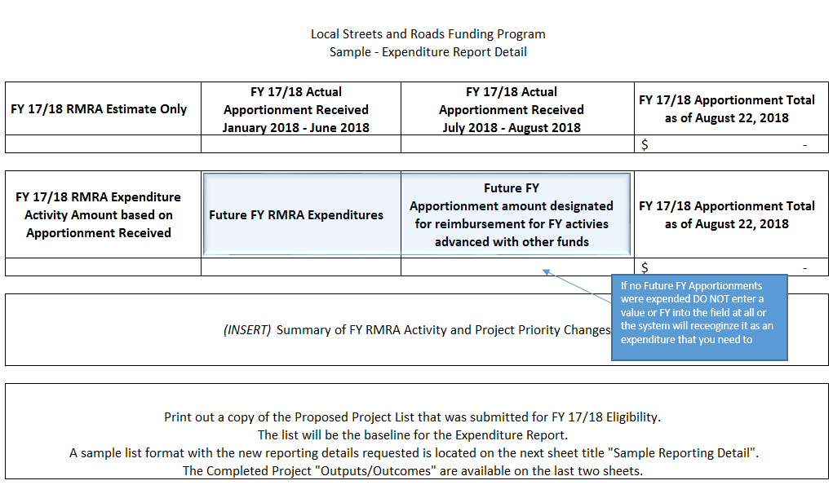
Using the Sample Worksheet
Using the 2017-18 Proposed Project List, Apportionment Data, Project Status, and Expenditure Information each Jurisdiction can begin collecting the baseline information needed for the expenditure report using the sample collection sheet we have provided. If you would like one please email LSR@catc.ca.gov.

Slide 10
Using the Sample Worksheet
Collect all reporting data prior to initiating your report, this will reduce errors and streamline the process.
Please note, we have built in dropdowns for select fields that will mirror your online system options.

Slide 11
Reporting Criteria – Completed Projects (Only)
Component.
The applicable “Component” must be selected, cities and counties may select from Construction, Pre-Construction, or Procurement/Operational Needs.
Project Award Date (if applicable).
Project Start Date (Cannot be after June 30, 2018).
Project Completion Date (Cannot be after June 30, 2018).
Enter the month and year that the project was completed/operational.
Additional Project Elements.
Additional Elements Description (optional)
RMRA Funds Expended.
Based on the project component activity performed within the FY in which costs were incurred.
Estimated Overall Project Cost.
Enter a minimum and maximum estimated useful life value in years.
Project Details Update – Cities/Counties must update the following project detail information to ensure accuracy:
Project Location
Legislative Districts
Project Title
Project Description
US Congressional District

Slide 12
Reporting Criteria – In Progress Projects (Only)
Component.
The applicable “Component” must be selected, cities and counties may select from Construction, Pre-Construction, or Procurement/Operational Needs.
Project Award Date (if applicable).
Project Start Date (Cannot be after June 30, 2018).
Estimated Project Completion Date (Any Date After June 30, 2018).
Enter the month and year that the project is estimated to be completed/operational.
Additional Project Elements.
Additional Elements Description (optional)
RMRA Funds Expended.
Based on the project component activity performed within the FY in which costs were incurred.
Estimated Overall Project Cost.
Enter a minimum and maximum estimated useful life value in years.
Project Details Update – Cities/Counties must update the following project detail information to ensure accuracy:
Project Title
Project Description
US Congressional District

Slide 13
Reporting Criteria – All Other Projects Originally Listed
Status
Carried Over & Forecasted
Component
The applicable “Component” must be selected, cities and counties may select from Construction, Pre-Construction, or Procurement/Operational Needs.
Est. Project Start & Completion Date
Additional Project Elements.
Additional Elements Description (optional)
Project Details Update – Cities/Counties must update the following project detail information to ensure accuracy:
Status
No Longer RMRA Funded
Additional Information
Brief Description (i.e. using other source funding for project, or not feasible at this time may consider RMRA funding in the future, etc.)

Slide 14
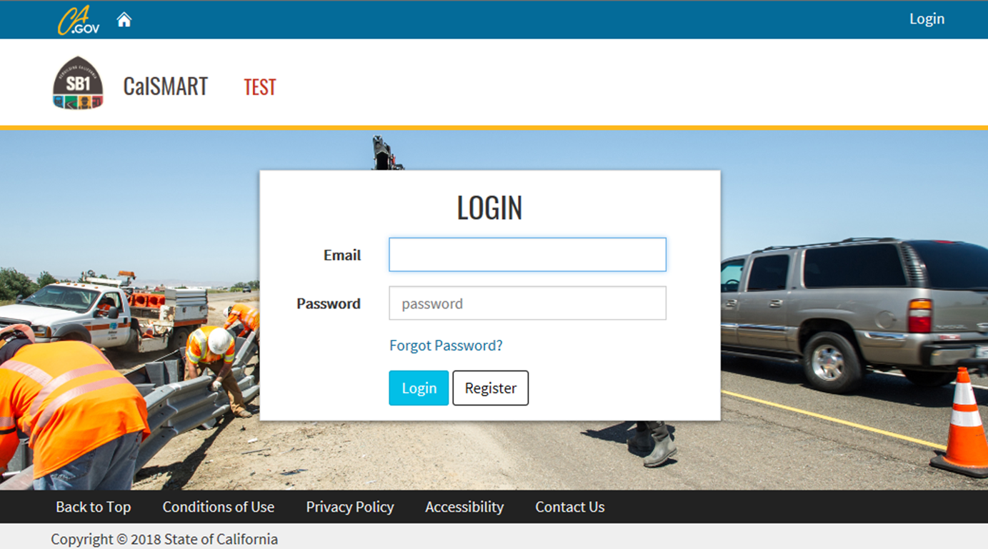
How Do I Access The System?
If you have not yet registered for CalSMART (formerly SB1 Program Project Intake Tool) online system, please ensure this is done immediately.
If you are unsure if you have registered for the online tool, you can check by clicking the “Register” tab.
https://calsmart.dot.ca.gov/login/auth

Slide 15
I am Having Issues Logging In!
https://calsmart.dot.ca.gov/login/auth
Enter your Username Email and Password and select “Login”.
User’s will have 3 failed password attempts prior to system lockout. We recommend you reset password after second failed attempt to avoid a lockout.
If you do not remember your Password, select “Forgot Password?”

Slide 16
My Report From FY 2017-18 Is Locked!
90% of the time, the user selected “Proposed Project Submittals” and not “Reporting”.
If you would like to print or view your 17/18 or 18/19 Proposed Project Lists select this tab. You cannot make any edits to of those submittals.
The “Reporting” tab will take you to all reporting functions, views, and feature for the Annual Project Expenditure Report.

Slide 17
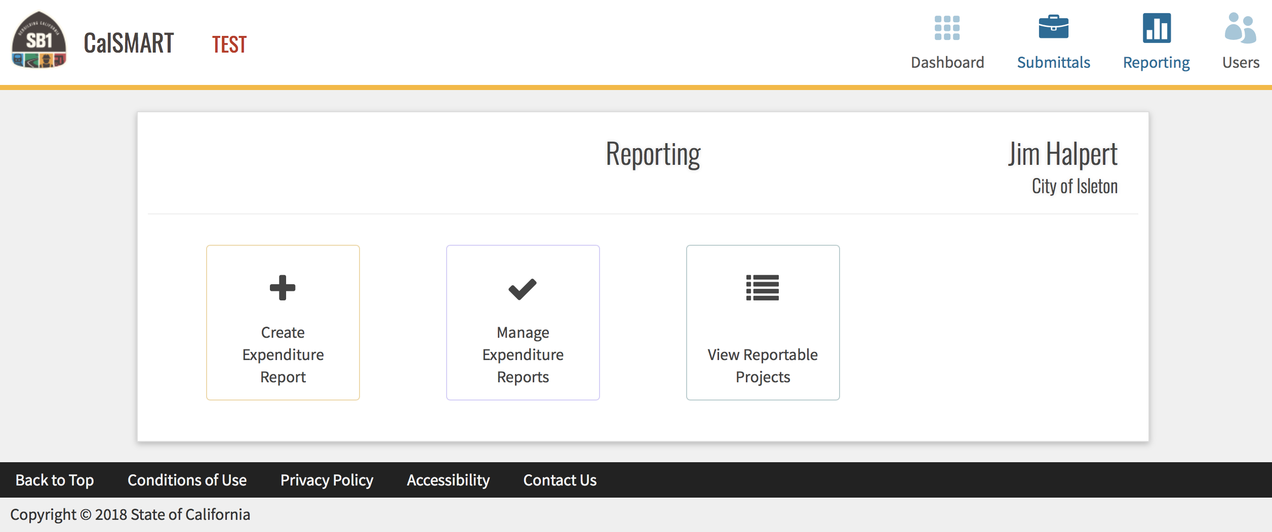
How do I Create and Manage the Expenditure Report?
Once an Expenditure Report is Initiated but not submitted, select either “View Reportable Projects” or “Manage Expenditure Reports” to edit or continue reporting.
If you are establishing the first “Expenditure Report” for your City/County, select “Create Expenditure Report”. The “New Expenditure Report” form will then appear. This form will be used to establish agency contact information, along with FY RMRA Apportionments Received.
Agency Name

Slide 18
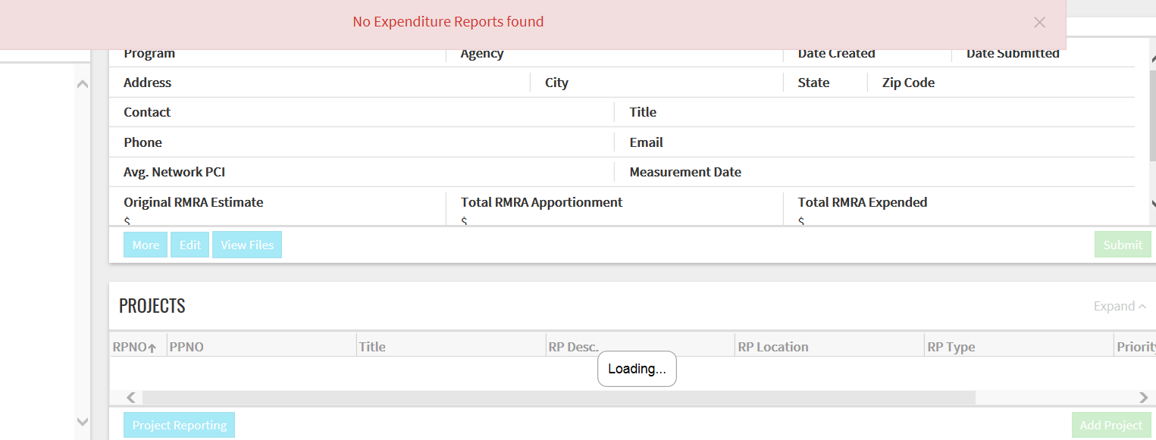
I Selected “Manage Expenditure Reports” and There is Nothing There?
If this appears after selecting “Manage Expenditure Reports”, your agency has not yet created an expenditure report. You must go back to the “Reporting” dashboard and select “Create Expenditure Report”.

Slide 19
New Expenditure Report – Intake Information
The “New Expenditure Report” is where you will update your agency contact information, enter the 2017-18 Apportionment detail, 2017-18 Expenditure detail, Average PCI (optional), Upload Documents (optional), and the Summary of FY RMRA Activity and Project Priority Changes.

Slide 20
Does The Amount Need To Be Exact For The Apportionments?
http://www.californiacityfinance.com/#TRANSPORTATION
This field will be automatically calculated based on the amounts entered into the “FY RMRA Apportionments Received”.
*If the individual totals and/or combined total for January – June and July – August do not match what was recorded by the SCO, Program Staff will send back for you to correct.

Slide 21
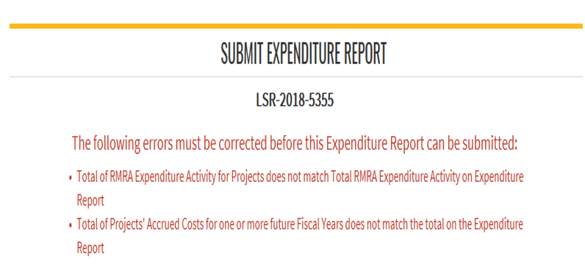
I Keep Getting An Error Notice That My Expended RMRA Doesn’t Match, but We Didn’t Spend Anything?
0.00
*If not applicable, leave blank do not enter a value of zero or the error notice above will appear.

Slide 22
Automated Expenditure Error Notice – Based on Apportionment
The reporting tool was built with automated verification measures to ensure accurate information is
entered into the system to in an effort to reduce user error. If a date outside of the allowable reporting period or dollar figure that does not equal the “New Expenditure Report” form intake data, error notices will generate and block you from submitting.

Slide 23
Why Do I Need To Provide A Summary, What Is It For?
This area provides an opportunity to explain or provide insight into your activity within the Fiscal Year.
If any changes to the “Proposed Project Lists” have occurred those changes should also be summarized here.
Once you have completed all required fields and you have ensured all amounts have correctly populated, select “Save and Continue”. The user will then be directed to the “Project Reporting” page.

Slide 24
Project Reporting – After Successfully Creating your Expenditure Report
“Project Reporting” is a project list replica of what was submitted to the Commission for Fiscal Year 2017-18 Program Funding Eligibility.
Each Project on your Proposed Project List must be accounted for prior to submitting the report. The system will not allow a user to submit until all projects are accounted for and the required information is provided.

Slide 25
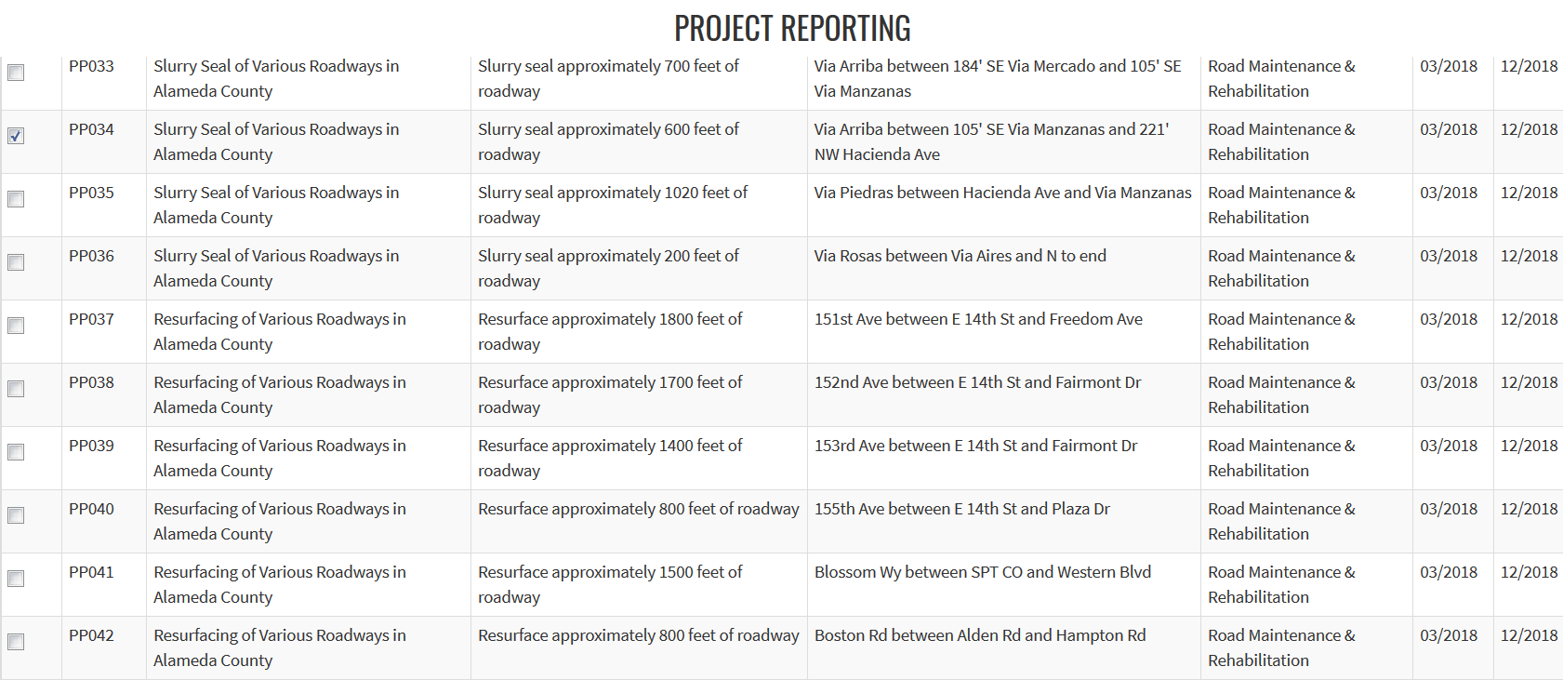
Project Reporting Actions – What should I choose?
The user must select at least one project to initiate a reporting action.
If only one project is selected, the following reporting actions are available.
No Longer RMRA Funded projects will not be using RMRA funding to complete the project, or the project has been cancelled.
If a project originally listed ended up being split into two or more projects for delivery, or you will/did expend RMRA funds in both the Pre-Construction and Construction phase, select that project and then select “Split Project”
Report Project As Originally Listed

Slide 26
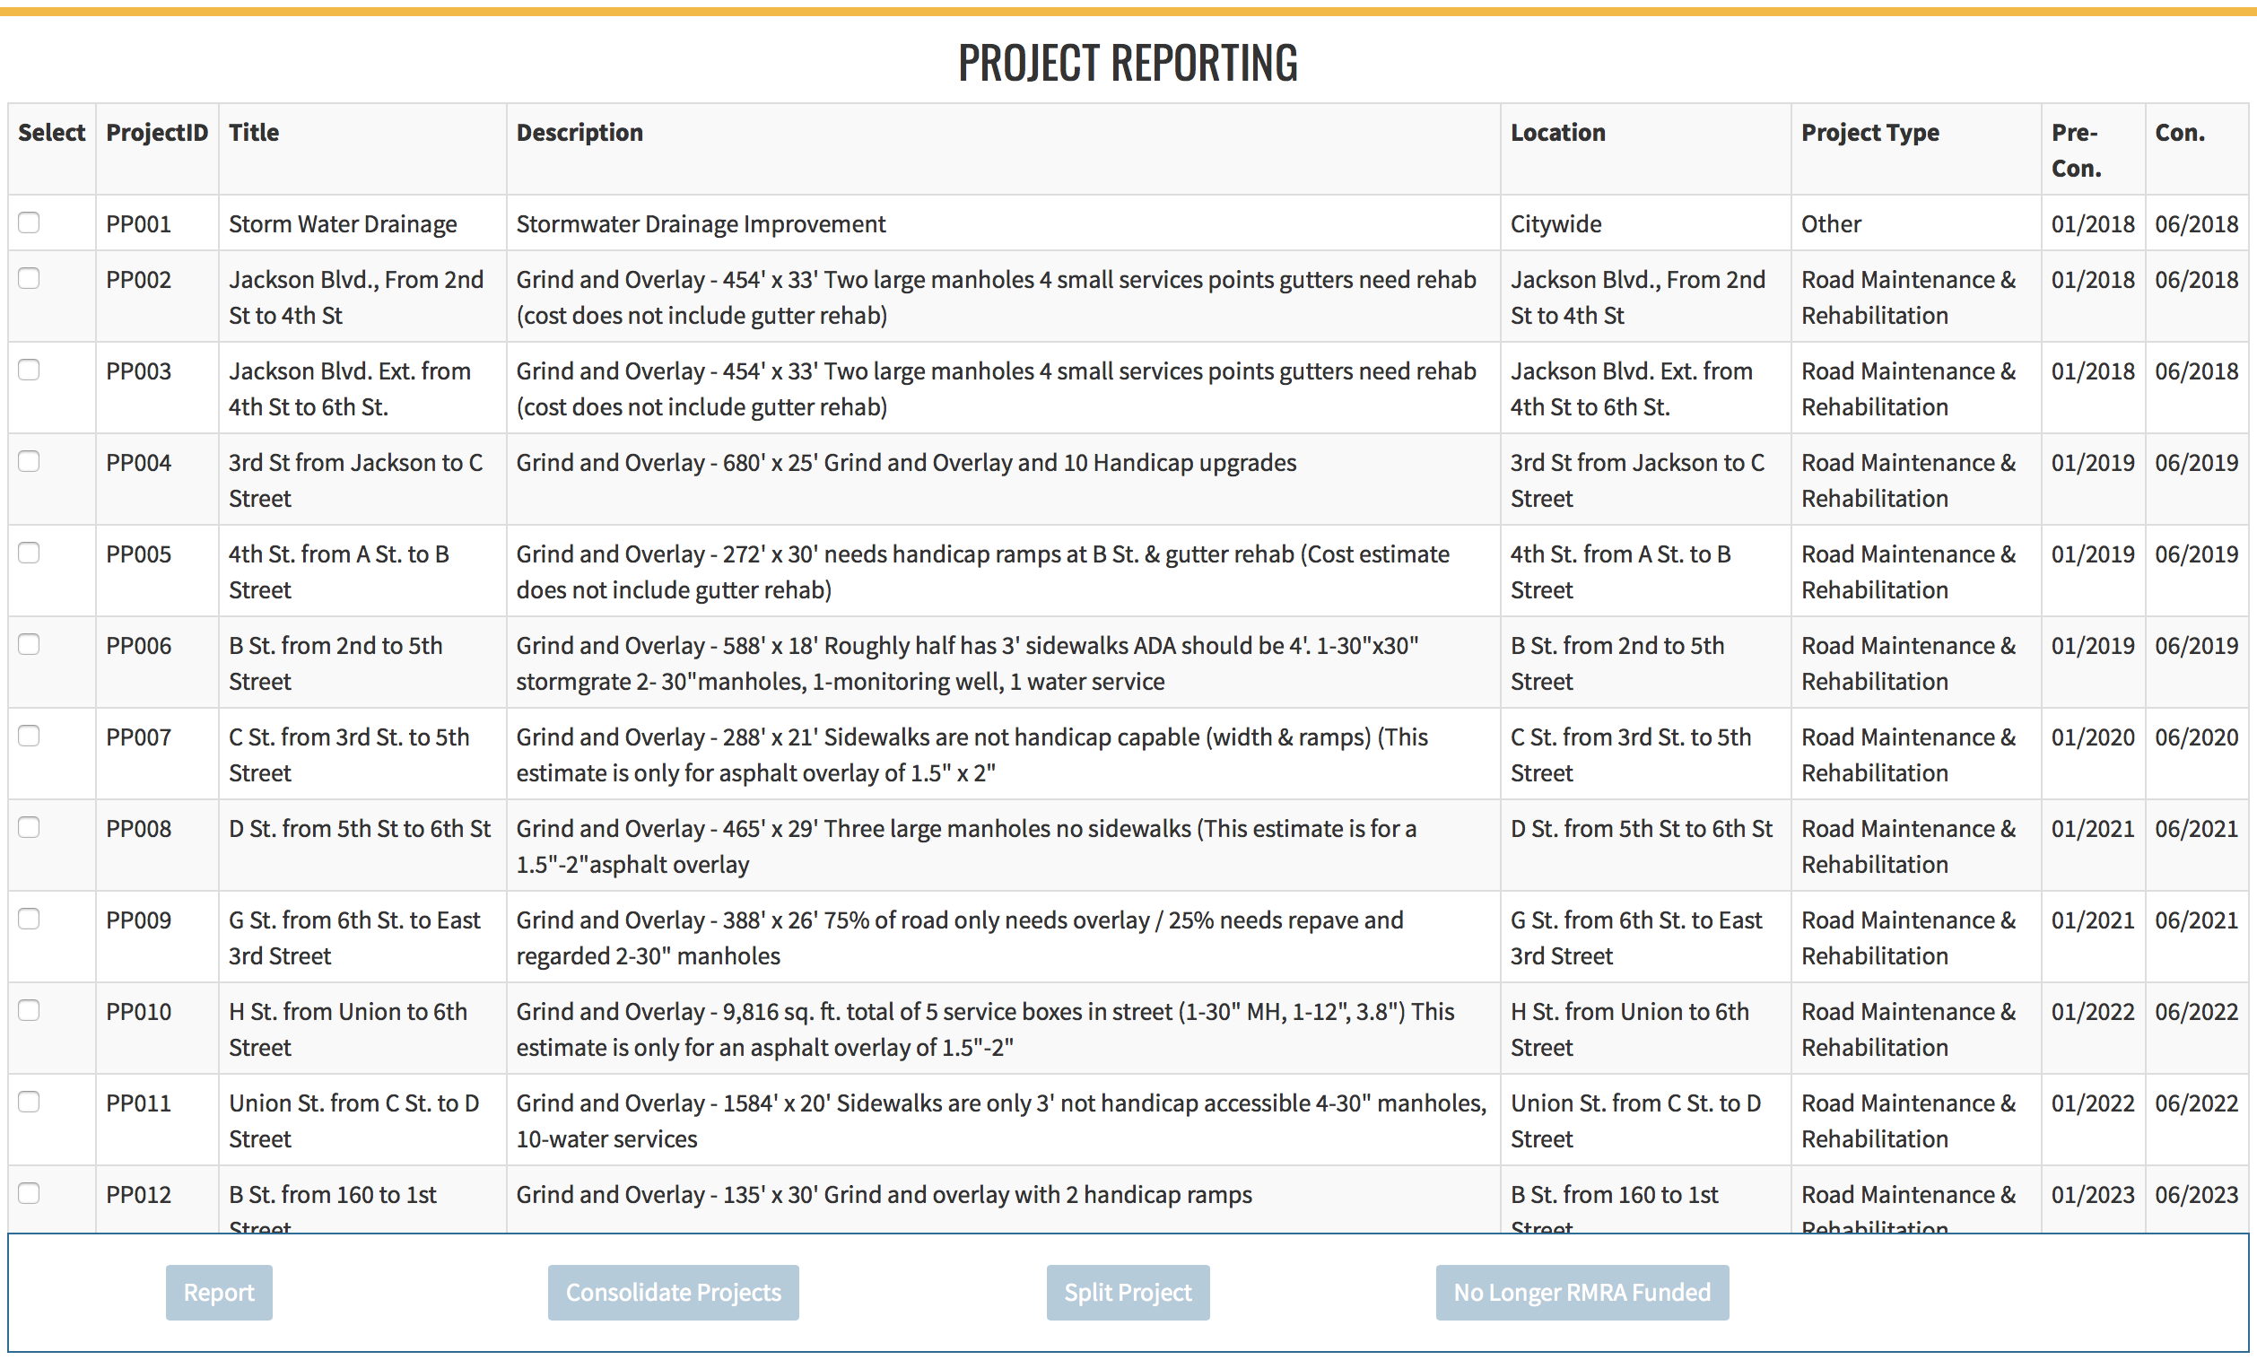
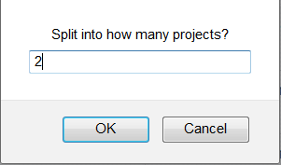
Project Reporting – Split Example
X
If a project is selected to be “Split” a message will appear in the middle of the page asking the user how many projects the original project is to be split into.

Slide 27
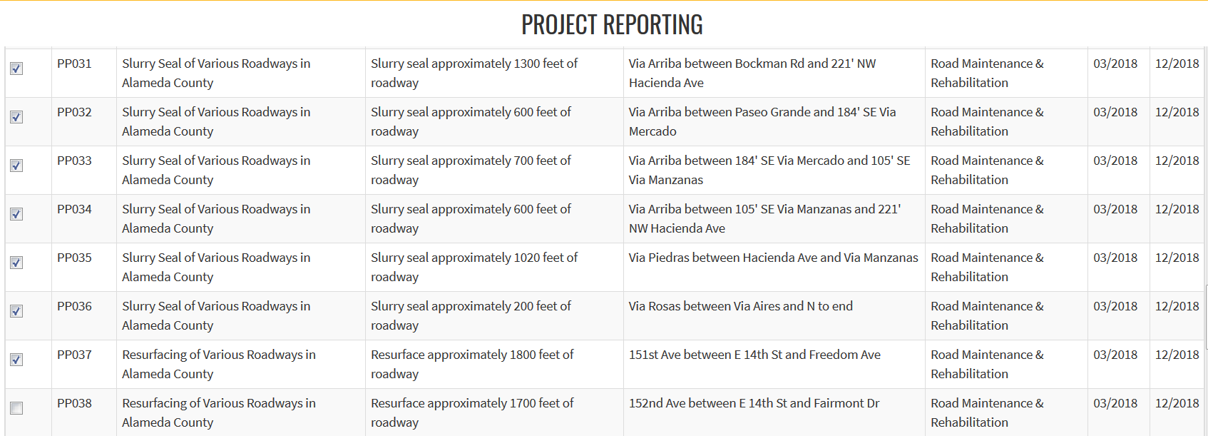
Consolidate/Group Projects
If multiple projects are selected only one reporting action will be accessible.
Jurisdictions will want to consolidate those projects that may have been listed by each segment/location to be performed instead of grouped under one contract or annual maintenance effort by the jurisdiction.
For example, if a jurisdiction reported 40 projects but 30 of the projects listed were to all be performed under one contract; those projects should be consolidated.
All 30 of those projects would only have to be reported on one time, with information entered only once instead of 30 separate entries.

Slide 28
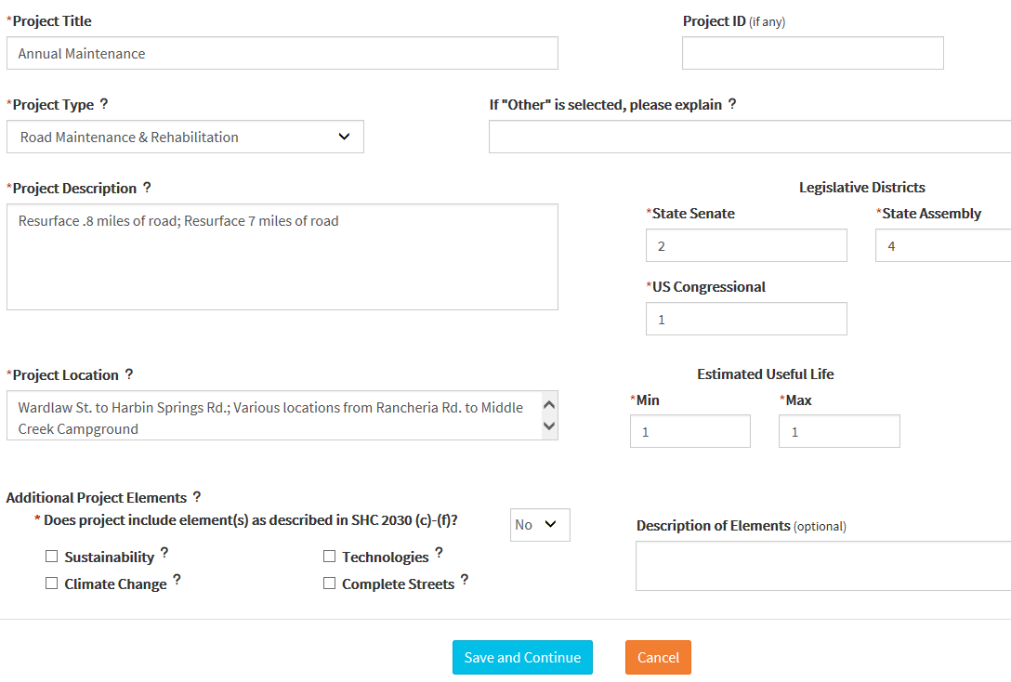
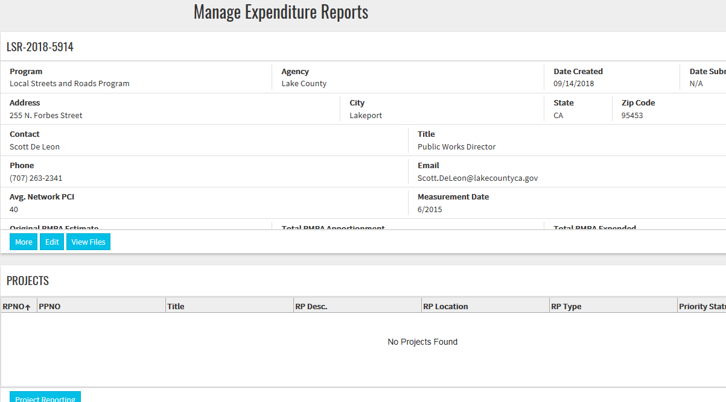
I Was In The Create Reportable Project Page And Closed/Timed Out Before Saving!
The information entered will not save and the “Project Reporting” list will reset. Just log back in, go to the “Reporting” tab, select “Manage Expenditure Reports” and select the “Project Reporting” tab to return to the list.

Slide 29
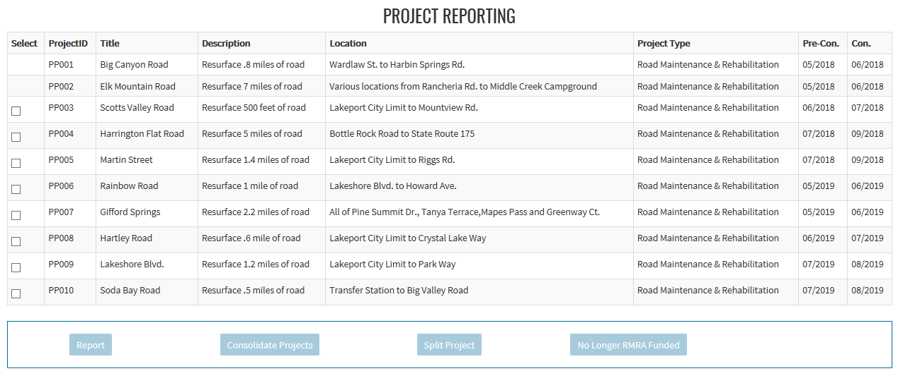
I Saved My Reportable Project But It Isn’t Showing Up In My Manage Expenditure Reports Page List And I Cant Access It In The Project List?
Go to the “Reporting” Dashboard and select “View Reportable Projects”.

Slide 30
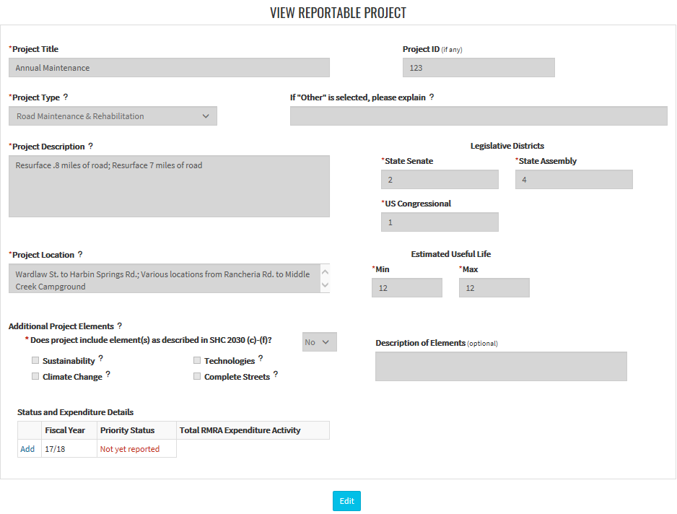
Incomplete Reportable Project
Click on the RPNO to complete the project report.
When “Not Yet Reported” appears in the status, it is indicating that you closed out from a reportable project prior to completing all required reporting fields.
Once the RPNO is selected you will be taken back the “View Reportable Project” detail page. All fields will be locked, scroll to the bottom under Status and Expenditure Details and click “Add” to be directed to the “Priority Status and Expenditure” detail page.

Slide 31
How Do I Know What Priority Status To Choose?
Project Priority Status – Should be selected based on activity, schedule, and component.
Project Status | Definition
Carried Over | Projects identified as “Carried Over” are projects which did not begin construction within the State FY as originally intended. Project activity was pushed to the FY 18/19.
In Progress | “In Progress” projects are projects which began in FY 17/18, however, they were not completed until after June 30, 2018.
Completed | “Completed” projects were open to the public in FY 17/18.
Forecasted | “Forecasted” projects are to be completed in future fiscal years, i.e FY 19/20 and beyond.
No Longer RMRA Funded | Projects “No Longer RMRA Funded” will not be using RMRA funding to complete the project, or the project has been cancelled.

Slide 32
I Can Only Enter Whole Numbers In The Outputs/Outcomes “Miles” Fields?
If you are ready to submit your report prior to the decimal fix, indicate in the “Additional Information” field what would be the accurate mileage or feet for that outcome.
One of our team will make the correction on your behalf.
The system will not currently accept decimals. A system correction is in the works and we hope to have it out shortly.

Slide 33
I Need To Edit My Reporting Action (Delete, Add, Etc.) How Can I Do That?
Contact the LSR@catc.ca.gov as soon as you realize you have made an error in your reporting list that does not appear to have an editable fix. We are currently working on a “Reset” reporting action feature but it is not ready yet.
The only way to make a change to the “Reporting Action” shown as “RP Type” on the list, is to go into the backend of the system and clear your entire report and have you start over.
We urge all agencies to use the “Sample Worksheet” to collect and sort your project list and reporting detail prior to initiating the online expenditure report in an effort to avoid these errors.

Slide 34
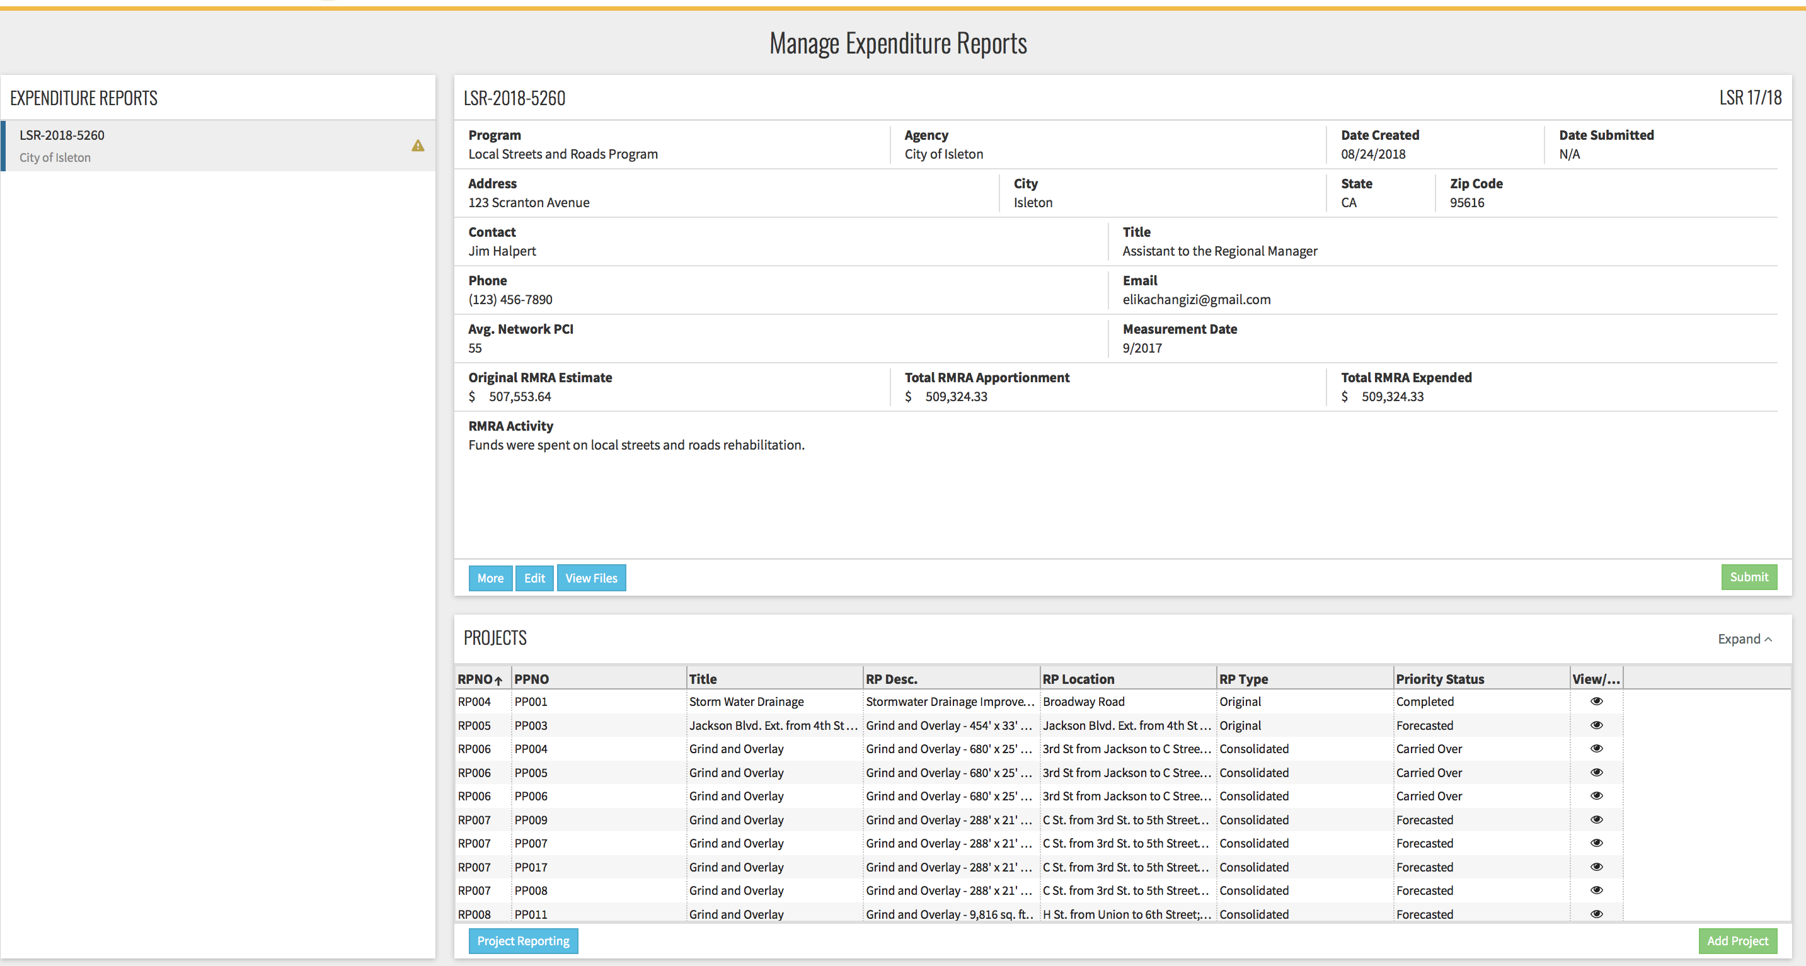
I Can’t Tell If My Report Was Submitted?
Not Submitted
If you believe you have submitted but did not receive a confirmation, check the “Manage Expenditure Reports” page. Most users that didn’t get a confirmation did not complete the submission process.
Be sure that when you select submit, you confirm you want to submit and that you received a confirmation email from the system.

Slide 35
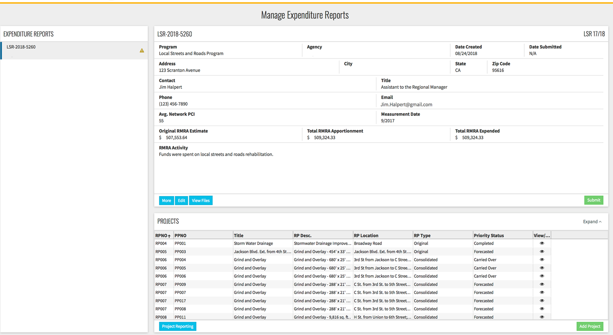
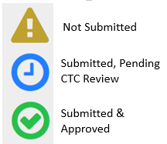
How Do I Know The Status Of My Expenditure Report?
Select “Manage Expenditure Reports”.
These are the applicable “Reporting Status” symbols.

Slide 36
How Can I Find The List Of Just The “Reportable Projects” Not All The Ones I Consolidated?
Only unique RPNOs will appear in the “View Reportable Projects” screen.

Slide 37
Annual Project Expenditure Report – Q & A
Q: “If we didn’t expend any of the Road Maintenance and Rehabilitation Account Local Streets and Roads Program Funds in the Fiscal Year do we still need to submit a report?”
A: Yes, regardless as to whether or not funds were expended in the fiscal year, per the program guidelines, each jurisdiction is required to provide an expenditure report updating the status and project details of the projects proposed for eligibility in FY 2017-18.
SHC Section 2032.5(a) It is the intent of the Legislature that the Department of Transportation and local governments are held accountable for the efficient investment of public funds to maintain the public highways, streets, and roads, and are accountable to the people through performance goals that are tracked and reported.
2019 Local Streets and Roads Funding Program Reporting Guidelines
http://catc.ca.gov/programs/sb1/lsrp/docs/081518_LSRP_Reporting_Guidelines_Adpoted.pdf

Slide 38
Annual Project Expenditure Report – Q & A
Q: “If we are no longer using RMRA funds for any of the projects we originally listed, we just designate them “No Longer RMRA Funded” and will not have any other projects on our expenditure report, correct?
A: If you are no longer funding any of the original proposed projects we do expect:
If no funds were expended in the FY and you are no longer going to use the funds on the proposed projects, you should add whatever project the City/County now intends to use those funds in the future.
If funds were expended, you will still need to add the project in which funds were expended on.
2019 Local Streets and Roads Funding Program Reporting Guidelines
http://catc.ca.gov/programs/sb1/lsrp/docs/081518_LSRP_Reporting_Guidelines_Adpoted.pdf

Slide 39
Annual Project Expenditure Report – Q & A
Q: “Why do we need to report based on component? We want to report based on design and build?
A: Reporting based on the “Component” performed is vital to the integrity of the data collected in this report. Unlike most of the other SB1 programs, these funds are not limited to just “Construction”. Therefore, we need to be able to capture when funds are used in Pre-Construction, the Pre-Construction Schedule, Status, Outcome/Outputs (if applicable), and specifically the RMRA Costs.
2019 Local Streets and Roads Funding Program Reporting Guidelines
http://catc.ca.gov/programs/sb1/lsrp/docs/081518_LSRP_Reporting_Guidelines_Adpoted.pdf

Slide 40
Annual Project Expenditure Report – Q & A
Q: “Why are we doing this report when we are already reporting our annual expenditures for the Annual Streets and Roads Report to the State Controller’s Office (SCO)?”
A: This specific “Expenditure Report” is a direct requirement of the Streets and Highways Code Section 2034(b) for the Commission to collect annually from the cities and counties.
Streets and Highways Code Section 2034(b) https://leginfo.legislature.ca.gov/faces/codes_displayText.xhtml?lawCode=SHC&division=3.&title=&part=&chapter=2.&article

Slide 41
Annual Project Expenditure Report – Q & A
Q: “What are Cities and Counties to do about their Maintenance Of Effort (MOE) if they are unable to meet it? How will this impact a City or County’s eligibility for RMRA or HUTA funding?
A: MOE compliance determination will be completed during an audit of the MOE; if during the audit, it is determined that an agency is not in compliance, RMRA funds received must be returned to the SCO. Returned funds will be reallocated to other agencies who were in compliance with requirements.
Streets and Highways Code (SHC) Sections 2030 - 2038
https://leginfo.legislature.ca.gov/faces/codes_displayText.xhtml?lawCode=SHC&division=3.&title=&part=&chapter=2.&article

Slide 42
State Controller’ Office - Contacts
Local Government Services Division, Apportionments
Erika Bosnich – Ebosnich@sco.ca.gov
Telephone – (916) 323-2892
Division of Audits
Efren Loste - AUDstreetsroads@sco.ca.gov
Telephone – (916)324-7226

Slide 43
Additional Resources
California Transportation Commission:
http://catc.ca.gov/
Local Streets and Roads Program:
http://catc.ca.gov/programs/sb1/lsrp/
Online Reporting Tool:
https://calsmart.dot.ca.gov/login/auth
State Controller’s Office:
https://www.sco.ca.gov/ard_local_apportionments.html - FY Apportionments
https://www.sco.ca.gov/aud_road_maintenance_sb1.html - FAQs Audits

Slide 44
Additional Resources
California State Association of Counties:
http://www.counties.org/
League of California Cities:
https://www.cacities.org/
California Local Government Finance Almanac:
http://www.californiacityfinance.com/

Slide 45
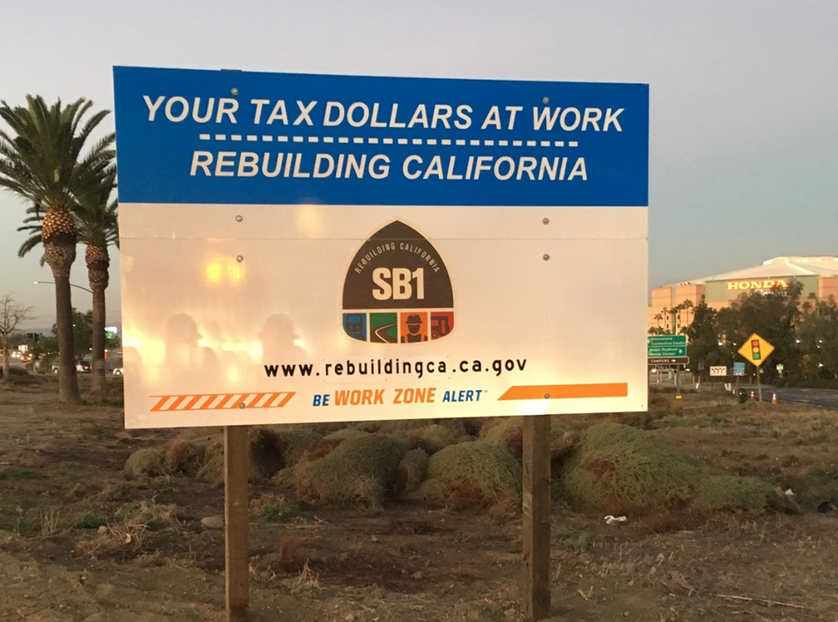
Thank You
More Information
Email: LSR@catc.ca.gov
Alicia.Sequeira@catc.ca.gov
CTC-LSR Program Website:
http://catc.ca.gov/programs/sb1/lsrp/

