Slide 1
Transportation Funding Deal Explained
Chris Lee
CSAC Legislative Analyst
April 28, 2017

Slide 2
SB 1 (Beall)
Approximately $5.2 billion/year in new revenue – no sunset
Approved by Legislature on April 6
Governor Brown will sign today
Accompanied by ACA 5 (Frazier), which provides constitutional protections for revenues

Slide 3
What taxes were part of the deal?
12-cent gas excise tax increase
Reset price-based excise tax at 17.3 cents
20-cent diesel excise tax increase
4% diesel sales tax increase
$25-$175 annual “transportation improvement fee” based on vehicle value
$100 annual zero emissions vehicle fee
CPI adjustments on excise taxes/fees

Slide 4
How will revenues be phased-in?
New fuel taxes begin in November 2017
The value-based transportation improvement fee begins in Spring 2018
The price-based excise tax will be reset July 1, 2019
New Zero Emissions Vehicles will begin to pay an additional registration fee for road maintenance in 2020

Slide 5
Where does the funding go?
$1.5 billion for state highways
$1.5 billion for local roads
$750 million for transit operations and capital
$685 million in loan repayments
$400 million for state bridges
$300 million for goods movement/freight projects
$250 million for the new “Solutions for Congested Corridors” program
$200 million for state-local partnership
$100 million for the Active Transportation grants
$25 million for Freeway Service Patrol
$25 million for local planning grants
$7 million for UC and CSU Transportation Research

Slide 6
Which revenues flow to counties?
Road Maintenance and Rehabilitation Account
New gas tax, transportation improvement fee, and part of diesel excise tax
50% state, 50% local
Local share split evenly between cities and counties
County revenues by SHC Section 2103 formula
75% on registered vehicles; 25% on road mileage

Slide 7
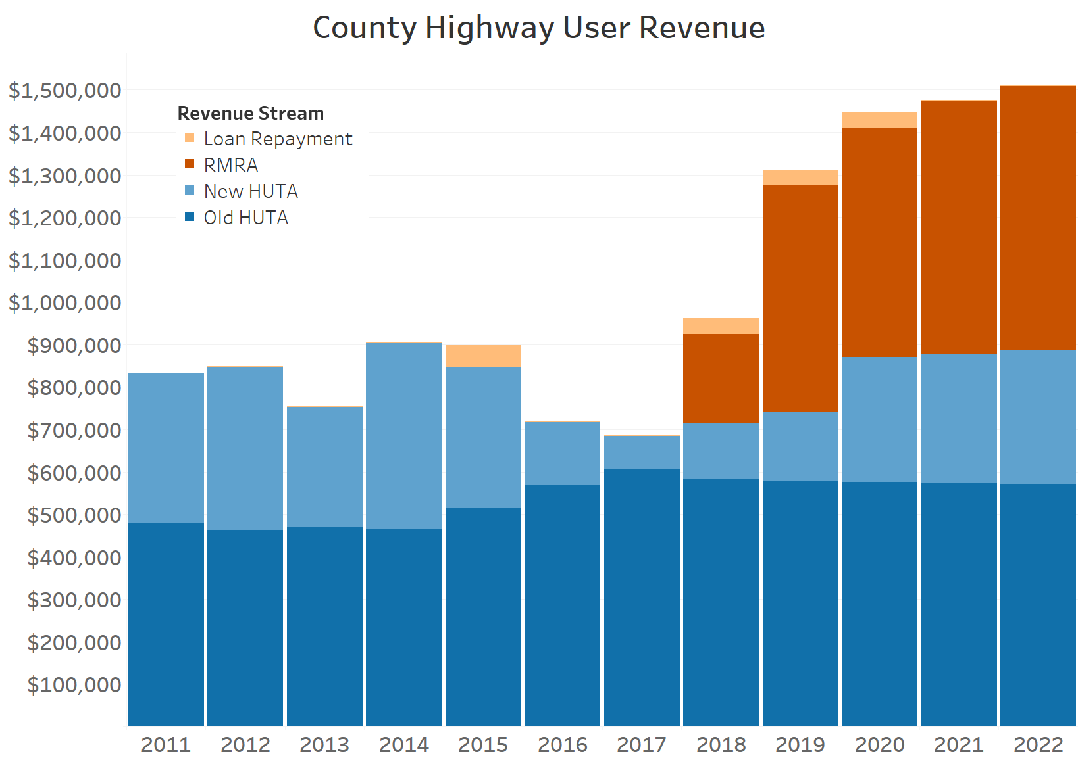

Slide 8
Competitive Funding Opportunities
Active Transportation Program – existing program
State-Local Partnership – new guidelines
Congested Corridors Program – new program
Goods Movement Program – new guidelines
Local Planning – guidelines to be developed
May CA Transportation Commission meeting will include guideline discussions

Slide 9
What county projects are eligible?
Road Maintenance and Rehabilitation Funding “shall be prioritized for expenditure on basic road maintenance and road rehabilitation projects, and on critical safety projects.” Streets and Highways Code Section 2030(a)

Slide 10
Eligible projects cont.
Eligible projects include, but are not limited to:
road maintenance and rehabilitation;
safety projects;
railroad grade separations;
complete street components, including active transportation, bike/ped, transit facilities, drainage, and stormwater capture projects;
traffic control devices;
match for state/federal funds for eligible projects.
Streets and Highways Code Section 2030(b)

Slide 11
What if my roads are in good shape?
May spend RMRA funds on other transportation priorities if average PCI meets or exceeds 80 (Streets and Highways Code Section 2037)
Constitutional limitations apply: “Research, planning, construction, improvement, maintenance, and operation of public streets and highways” and related nonmotrized facilities for nonmotorized traffic (Art. XIX, Sec. 2(a))

Slide 12
What are the reporting requirements?
List of projects proposed to be funded each year to California Transportation Commission
List must be pursuant to an adopted budget approved at a public meeting
List shall not limit flexible use of funds, provided that projects are eligible
Must include description and the location of each proposed project, schedule for completion, and estimated useful life of improvement

Slide 13
Reporting requirements cont.
Upon expending RMRA funds, must submit documentation to the CTC
Description and location of each completed project,
Amount of funds expended on the project
Completion date and the estimated useful life of the improvement
Streets and Highways Code Section 2034(a)(2)

Slide 14
Questions?
Chris Lee CSAC Legislative Analyst clee@counties.org 916-650-8180

